Slide 1

BETWEEN A ROCK
• • •
and a hard place
Intersectional experiences, stigma-related stress, and behavioral health among Black LGBTQ+ individuals
Skyler Jackson, PhD
Assistant Professor (he/him)
Department of Social and Behavioral Sciences
Yale School of Public Health
Pathways to Wellness
African American Training & Tech Assistance Program
Presented December 1, 2023

Slide 2
Poll 1: How often you see Black/African American LGBTQ+ people in your practice?
Often
Sometimes
Rarely
Never
I’m not sure

Slide 3
Poll 2: What is your level of familiarity with Black/African American LGBTQ+ mental health?
No clue! I’ve never even thought about it (no knowledge).
I have thought about it, but don't really know the populations concerns--e.g., wouldn't be able to explain them to someone else (minimal knowledge).
Read an article/saw a clip/friend tried to explain (basic knowledge)
Read a book/attended a training; some community contact (moderate knowledge)
Ongoing learning; read multiple books and/or attended multiple trainings; lots of community contact (expert knowledge)

Slide 4
Today’s Learning Objectives
By the end of the day, you will be able to…
Articulate the dominant theory explaining the mental health disparities between LGBTQ+ people and their cisgender/heterosexual counterparts.
Rank how the mental health of Black LGBTQ+ individuals compares to their Black cisgender and heterosexual counterparts.
Distinguish between distal LGBTQ+ minority stressors and proximal LGBTQ+ minority stressors.
Identify the two dominant forms of intracommunity stigma that shape the lives of Black LGBTQ+ people.
Recall three studies that incorporate intersectional theory to study the behavioral health of Black LGBTQ+ people.
Provide an example of how intersectionality can be applied an evidence-based treatment to address the unique needs of Black LGBTQ+ people.

Slide 5
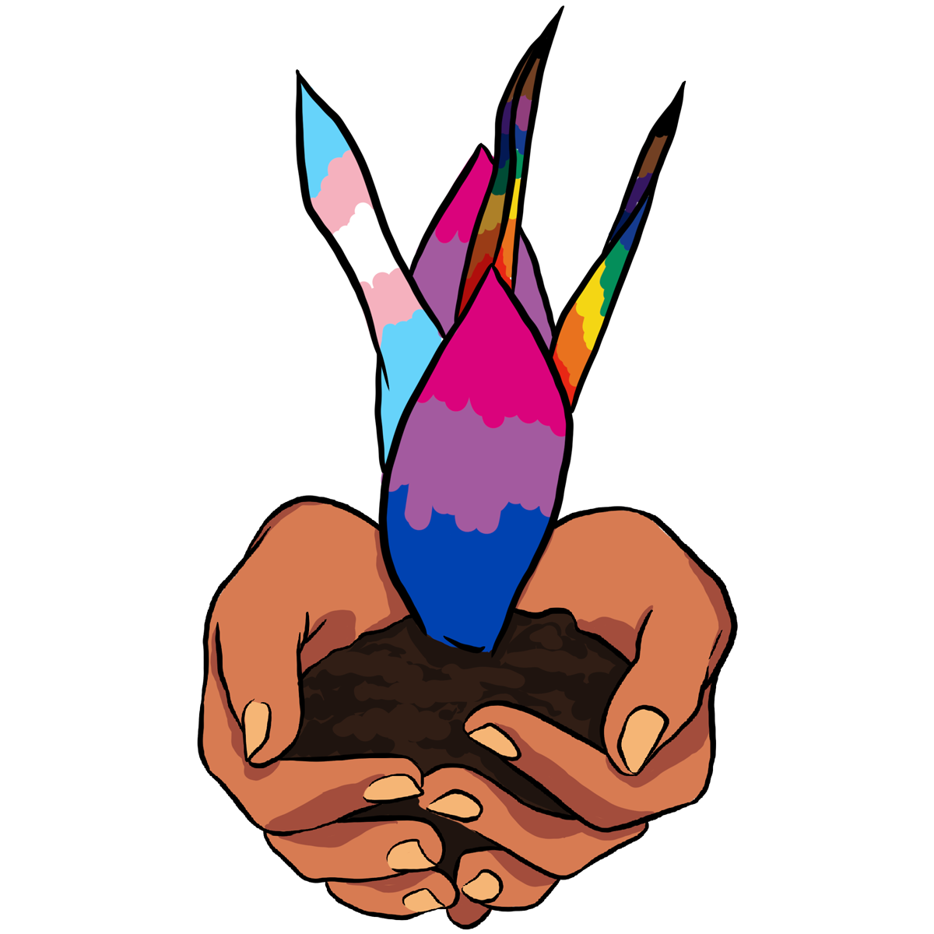
Part 1
To Intersectionality and Beyond! Overviewing Foundational Theories and Examining the Seeds of Prejudice

Slide 6
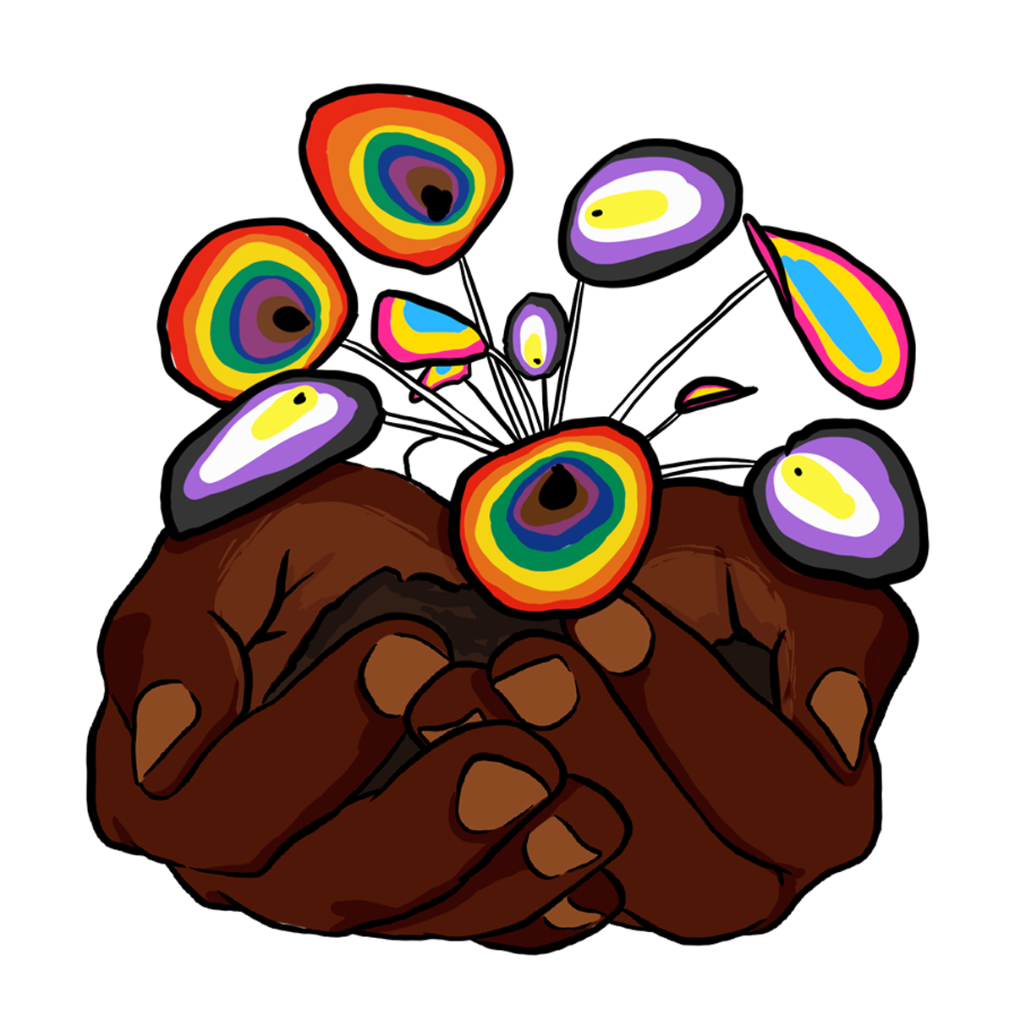
Part 2
Intersectional Experiences, Stigma-Related Stress, and Mental Health Among Black LGBTQ+ Individuals

Slide 7
Part 3
Promoting Black LGBTQ+ Health and Well-Being: From Intersectional Interventions to Clinical Attitudes

Slide 8
Presenter Background

Slide 9
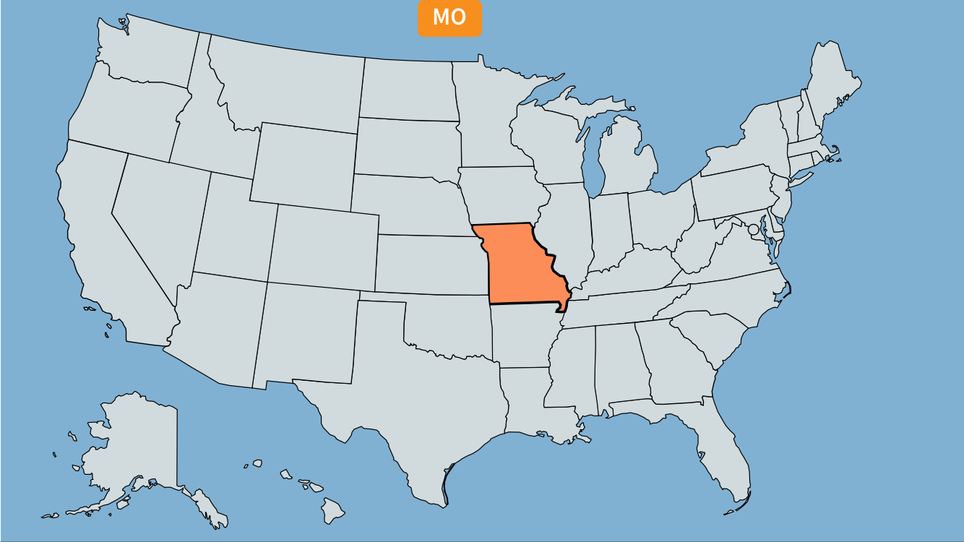


Slide 10


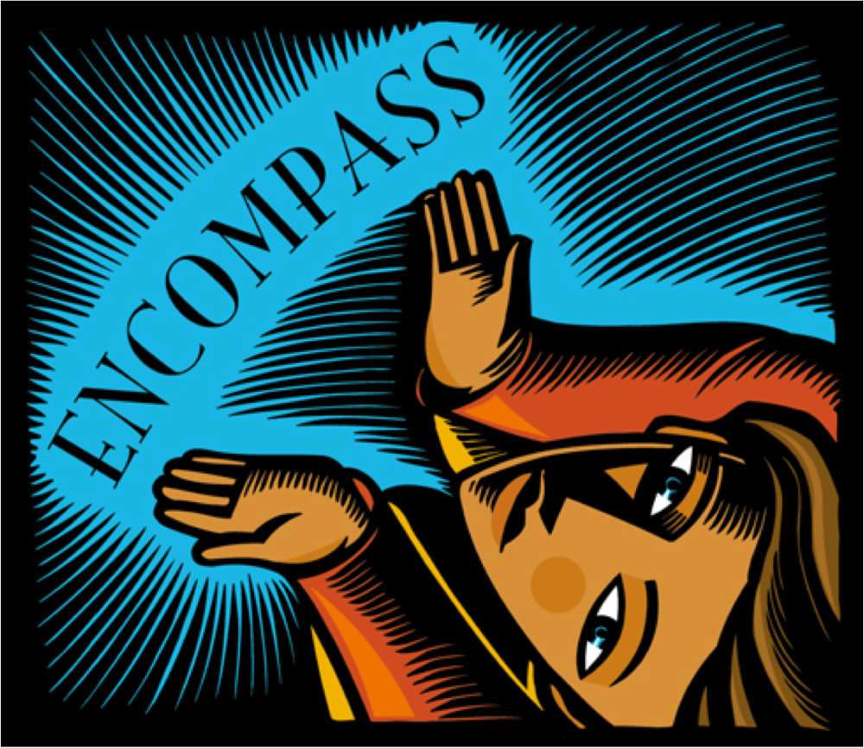

Slide 11
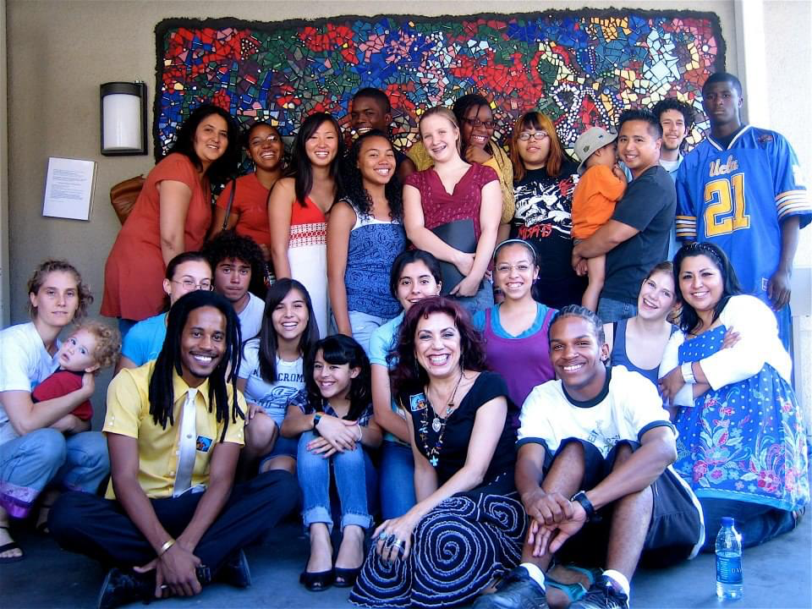
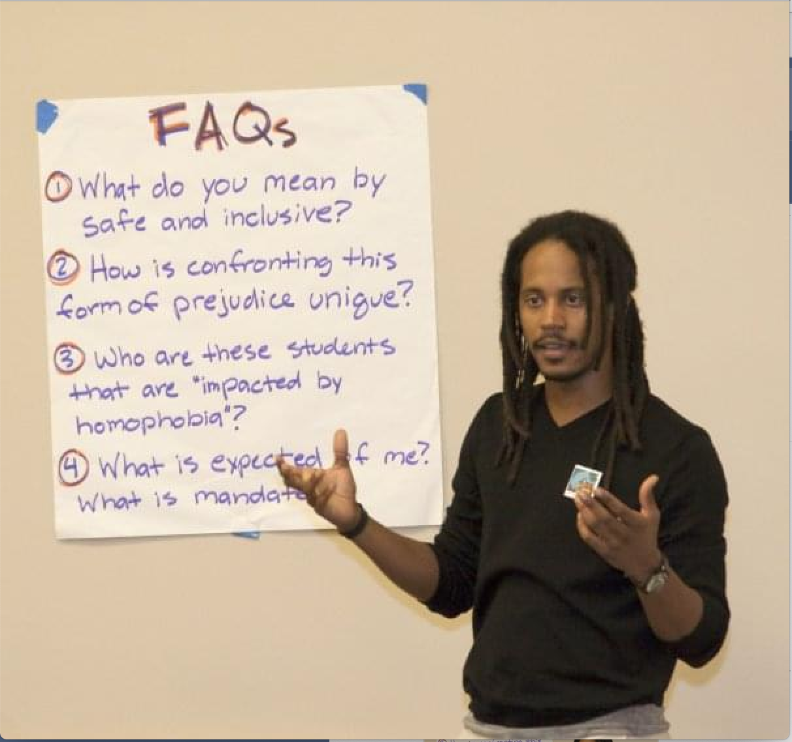
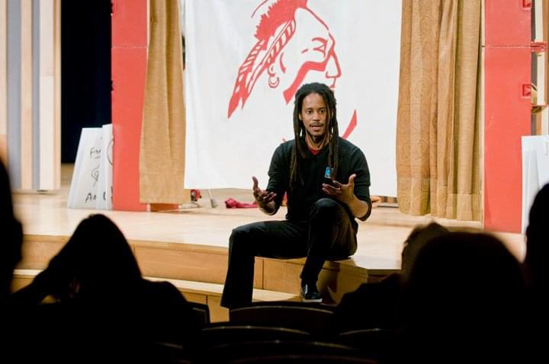
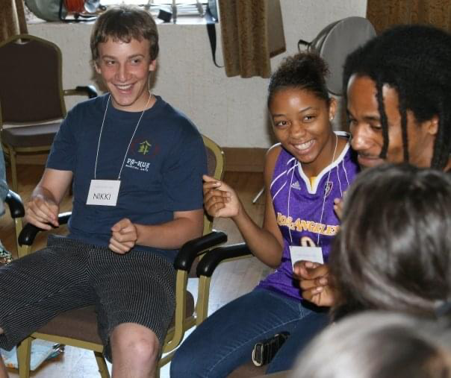
Mission: To Reduce Prejudice and Intergroup Conflict among California Teenagers

Slide 12



Slide 13

Stigma and Health Outcomes
Perceived discrimination predicts health (Pascoe & Smart Richman, 2009)
  ⬇ Physical health (e.g., hypertension, breast cancer)
  ⬇ Mental health (e.g., depression, anxiety, psychological distress, well-being)
  ⬆ Disease risk factors (e.g., obesity, high blood pressure, substance use)
  ⬆ Physiological responses (e.g., heart rate, cortisol secretions)

Slide 14
Program of Research
Lens of
Intersectionality
IDENTITY
STIGMA
HEALTH

Slide 15


Slide 16
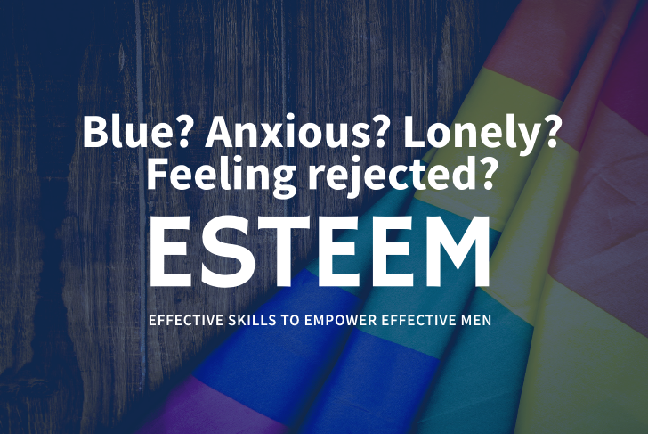
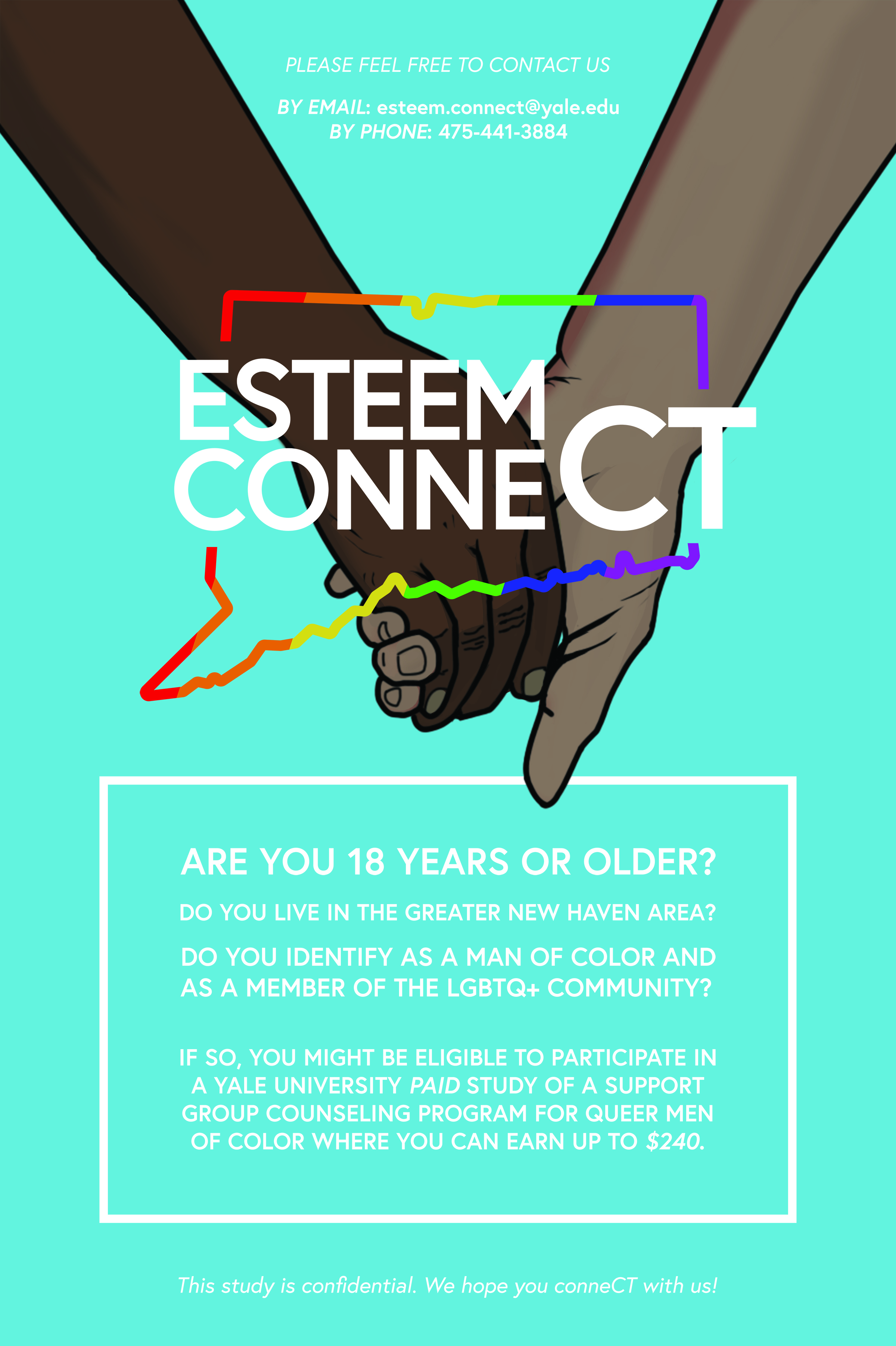
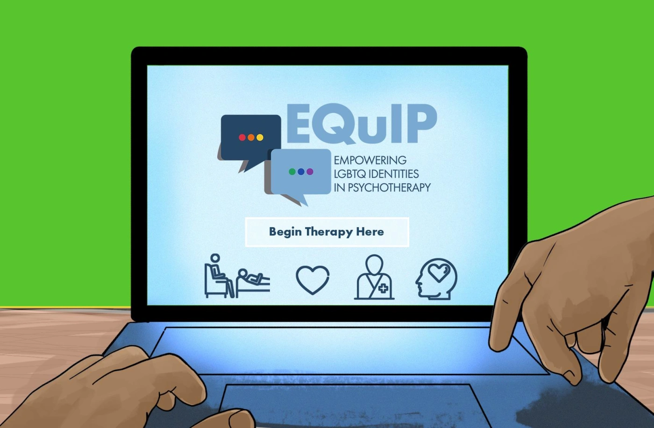

Slide 17
Part 1
To Intersectionality and Beyond! Overviewing Foundational Theories and Examining the Seeds of Prejudice

Slide 18
Foundational Theories
Minority Stress, Psychological Mediation Framework, and Intersectionality

Slide 19
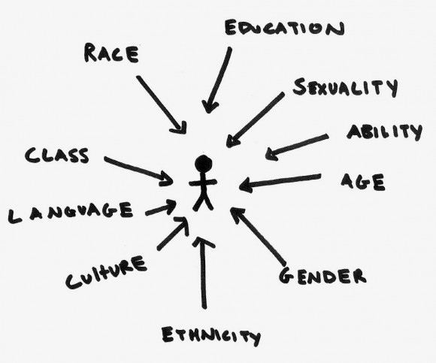

Slide 20
Stigmatized Groups (select)
Muslim Deaf Bisexual Asian HIV Positive
Intersex Native American Poor Transgender
Schizophrenia Latinx Atheist Middle Eastern
Women Bipolar Queer Asexual Dyslexia Black
Disability Multiracial Pagan Immigrant Jewish
Blind Homeless Indigenous Autism Elderly

Slide 21
Stigmatized Groups (select)
Sex and
Racial
Sexual
Gender
Identity
Orientation
Cisgender Woman | Asian | Lesbian
Intersex | Black | Gay
Gender non-binary | Multiracial | Bisexual/Pansexual
Genderqueer | Native/Indigenous | Queer
Trans man | Latinx | Same-gender loving
Trans woman | Middle Eastern | Asexual

Slide 22
How does stigma get under the skin?
Biopsychosocial Model of Racism
Anderson et al. 1995; Clark, 1999
Theory of Embodiment
Krieger, 1999/2014
Psychological Mediation Framework
Hatzenbuehler, 2009
Minority Stress Theory
Meyer, 2003
Racism-related Stress
Harrell, 2000
Racial Battle Fatigue
Smith et al., 2004/2007
Objectification Theory
Fredrickson & Roberts, 1997

Slide 23
Enduring Disparities
LGBTQ
Heterosexual/Cisgender
Swedish National Public Health Survey; US National Epidemiologic Survey of Alcohol and Related Conditions; California Quality of Life Survey; TransPop; Generations

Slide 24
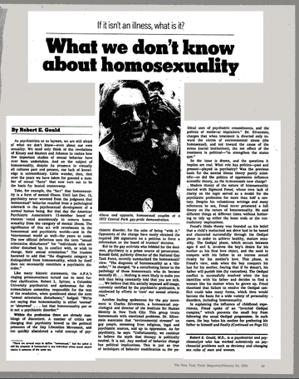
Minority Populations & Mental Health
Long-held belief in psychology and psychiatry…
Certain minority demographics prone to pathology/illness
Driven by essentialist notions of social demographics
  Gays/lesbians/bisexuals
  Black people
  Women
  Transgender people

Slide 25
Minority Stress Theory (Brooks, 1981; Meyer, 2003)
Among LGBTQ populations, increased…
erodes
erodes
Distal
Stressors
Proximal Stressors
Health Outcomes
Homophobia in one’s external environment:
Anti-LGBTQ laws
Hate crimes; violence
Job discrimination
Microaggressions
Internal identity-related stress processes:
Expecting stigma
S/O concealment
Self-stigma
Mental and physical health issues:
Depression/Anxiety
Suicide risk
Substance use
Sexual compulsivity

Slide 26
Minority Stress Processes (e.g., LGBTQ people)
Distal Events
Internal Processes
Health
PROXIMAL
e.g., internalized homophobia
PROXIMAL
LGBTQ+ STRESSORS
(internal + identity-related)
+
+
DISTAL
e.g., homophobic discrimination
Mental Health
(e.g., anxiety, depression, suicidality, substance abuse)
DISTAL
LGBTQ+ STRESSORS
(external + identity-related)
+
GENERAL STRESSORS
(e.g., emotion dysregulation, rumination, social isolation)
+
+
Psychological Mediation Framework (Hatzenbuehler, 2009)
Direct effect
Mediation pathway

Slide 27
Reflection
Where did I get my views related to sexual orientation and gender identity?

Slide 28
None of us were born with a biases towards LGBTQ+ people or issues.
What factors influenced your personal views towards LGBTQ+ people, for better or for worse?

Slide 29
LEVEL OF CONTACT
Consider how much contact you had with LGBTQ+ individuals while you were growing up? Did you have any close friends or relatives that did not identify as heterosexual? Any who were not cisgender?
RELIGIOUS VIEWS
Consider whether or not your religious or spiritual background influences your views on sexual orientation and gender diversity? For example, did you grow up feeling that homosexuality is natural? Growing up, were you taught that being gay or lesbian is a sin?
HOME ENVIRONMENT
Did your parents’ views of LGBTQ+ people influence your personal views? Consider whether or not you grew up in a household where homophobic or transphobic language was considered normal, one where sexual and gender diversity was openly celebrated, or one where LGBTQ+ people and issues weren’t discussed at all.

Slide 30
SCHOOL ENVIRONMENT
Did your peers’ views of LGBTQ+ influence your personal views? Consider whether or not you attended schools where homophobic or transphobic jokes were common, one where sexual and gender diversity was openly celebrated, or one where LGBTQ+ people and issues weren’t discussed at all.
GENDER VIEWS
How much do your beliefs about masculinity and femininity influence your views of LGBTQ+ people? Consider whether or not you grew up thinking that the idea of gay men weren’t “real men” or that all lesbians were masculine and un-ladylike?
PERSONAL EXPERIENCES
Have you had significant negative experiences with a LGBTQ+ people that may influence your views on sexual orientation? What about positive experiences? Or, do you personally identify as LGBTQ+?
MEDIA REPRESENTATION
What depictions of LGBTQ+ people did you experience in the media growing up? What representations do you see today? How have the images of LGBTQ+ presented in the media impacted your views on sexual orientation and gender diversity?

Slide 31
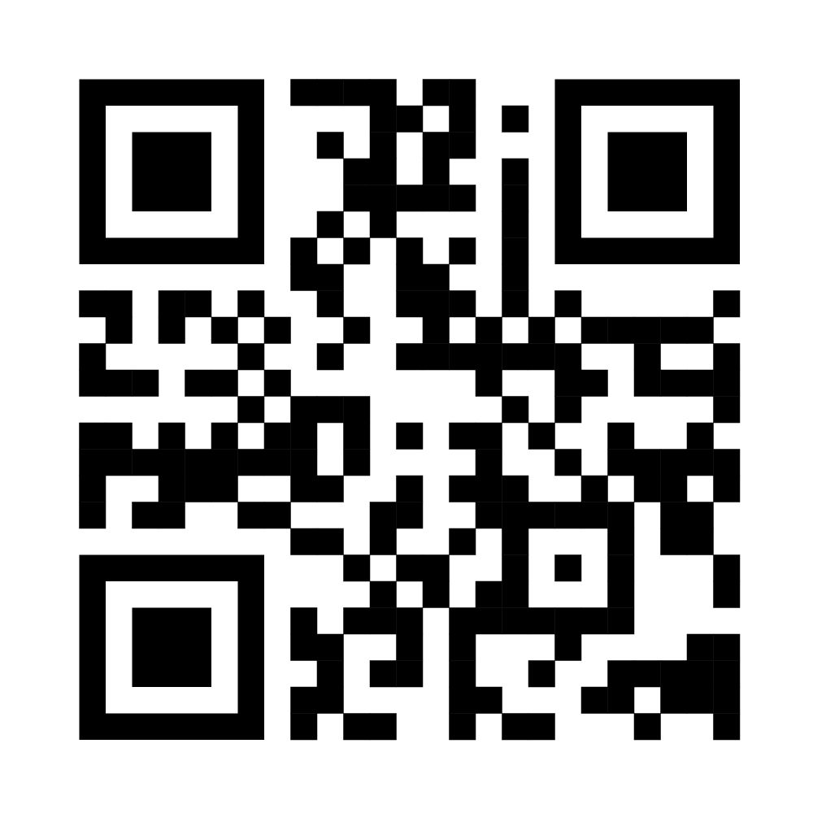
Self-Assessment Activity
Please Scan the QR Code
…or click the weblink in the chat

Slide 32
Rank
Which items made you more open/accepting towards sexual & gender diversity? Rank the top three (“1” being the item most responsible for your openness)
__ LEVEL OF CONTACT
__ RELIGIOUS VIEWS
__ HOME ENVIRONMENT
__ SCHOOL ENVIRONMENT
__ GENDER VIEWS
__ PERSONAL EXPERIENCES
__ MEDIA REPRESENTATION
2
1
3

Slide 33
Poll 3a: What did you rank for #1?
Level of contact
Religious views
Home environment
School environment
Gender views
School environment
Gender views

Slide 34
Rank
Which items made you less open/accepting towards sexual & gender diversity? Rank the top three (“1” being the item most responsible for your openness)
__ LEVEL OF CONTACT
__ RELIGIOUS VIEWS
__ HOME ENVIRONMENT
__ SCHOOL ENVIRONMENT
__ GENDER VIEWS
__ PERSONAL EXPERIENCES
__ MEDIA REPRESENTATION
2
1
3

Slide 35
Poll 3b: What did you rank for #1?
Level of contact
Religious views
Home environment
School environment
Gender views
School environment
Gender views

Slide 36
Rank
Which three items impacted your views on sexual orientation and gender identity the most overall? Rank the top three (“1” being the item most responsible for your views)
__ LEVEL OF CONTACT
__ RELIGIOUS VIEWS
__ HOME ENVIRONMENT
__ SCHOOL ENVIRONMENT
__ GENDER VIEWS
__ PERSONAL EXPERIENCES
__ MEDIA REPRESENTATION
3
1
2

Slide 37
Poll 3c: What did you rank for #1?
Level of contact
Religious views
Home environment
School environment
Gender views
School environment
Gender views

Slide 38
None of us were born with a biases towards LGBTQ+ people or issues.
What factors influenced your personal views towards LGBTQ+ people, for better or for worse?

Slide 39
Drawing Outside of the Lines
Gender
Race/
Sexual
Identity
ethnicity
Orientation
Cisgender Woman | Asian | Lesbian
Intersex | Black | Gay
Gender non-binary | Multiracial | Bisexual/Pansexual
Genderqueer | Native/Indigenous | Queer
Trans man | Latinx | Same-gender loving
Trans woman | Middle Eastern | Asexual

Slide 40
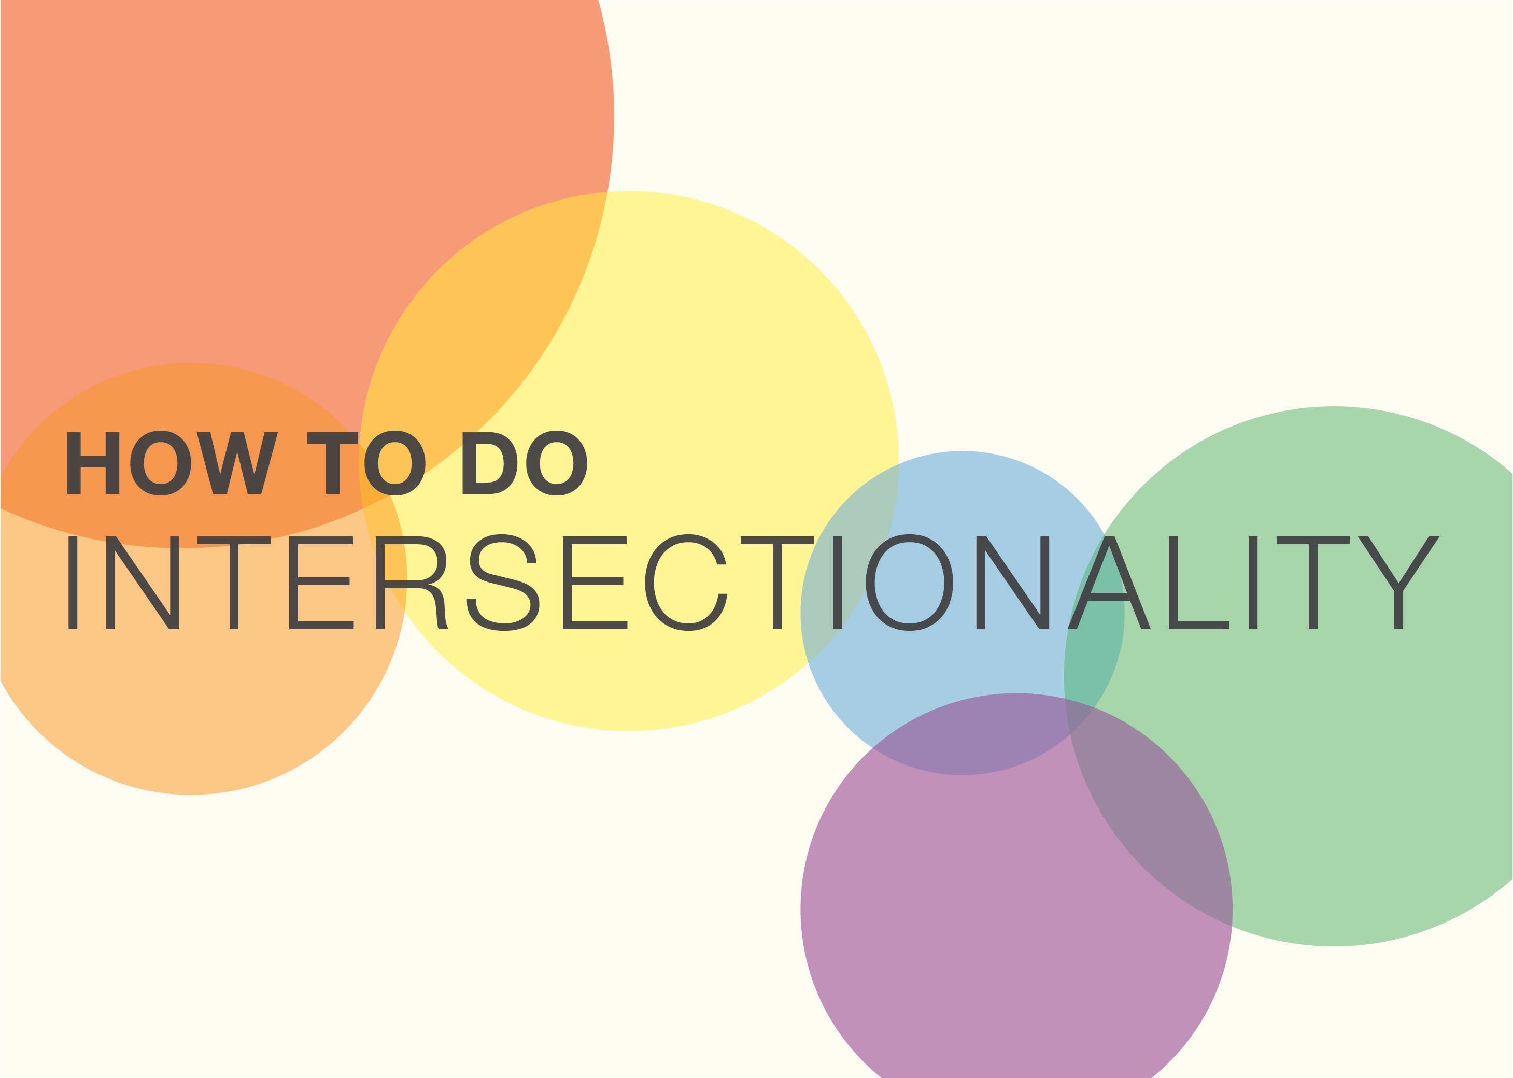
What is…

Slide 41
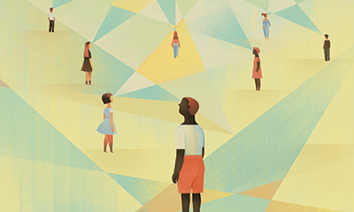
Framework of Intersectionality
Roots in Black feminist activism, legal studies, and critical race theory
Aims to understand people unique experiences, risks, and resiliencies of people impacted by multiple systems of power
Argues their experience is greater than a sum of its parts
To understand interlocking nature of oppression, best to assess simultaneously, in integrated manner

Slide 42
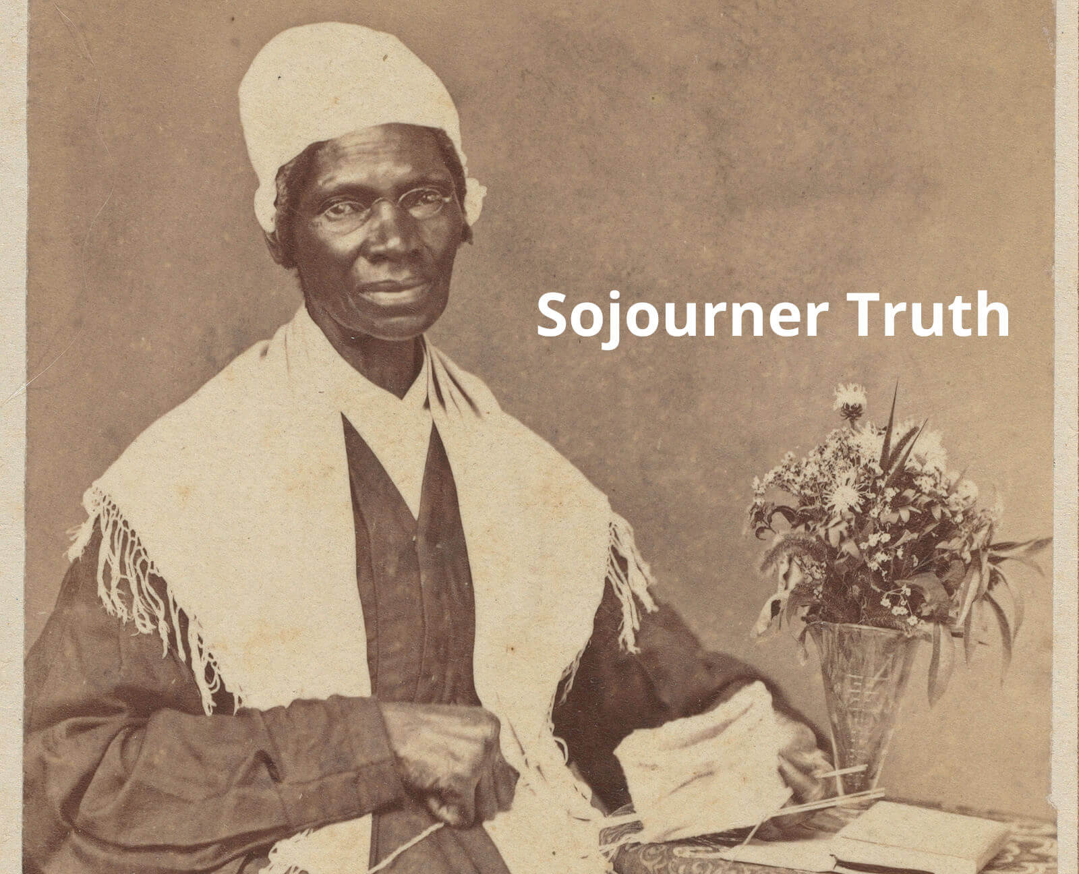
Long History
“That man over there says that women need to be helped into carriages, and lifted over ditches, and to have the best place everywhere. Nobody ever helps me into carriages, or over mud-puddles, or gives me any best place! And ain’t I a woman?”
Ain’t I a Woman?
1851 Women's Rights Convention
Akron, Ohio

Slide 43
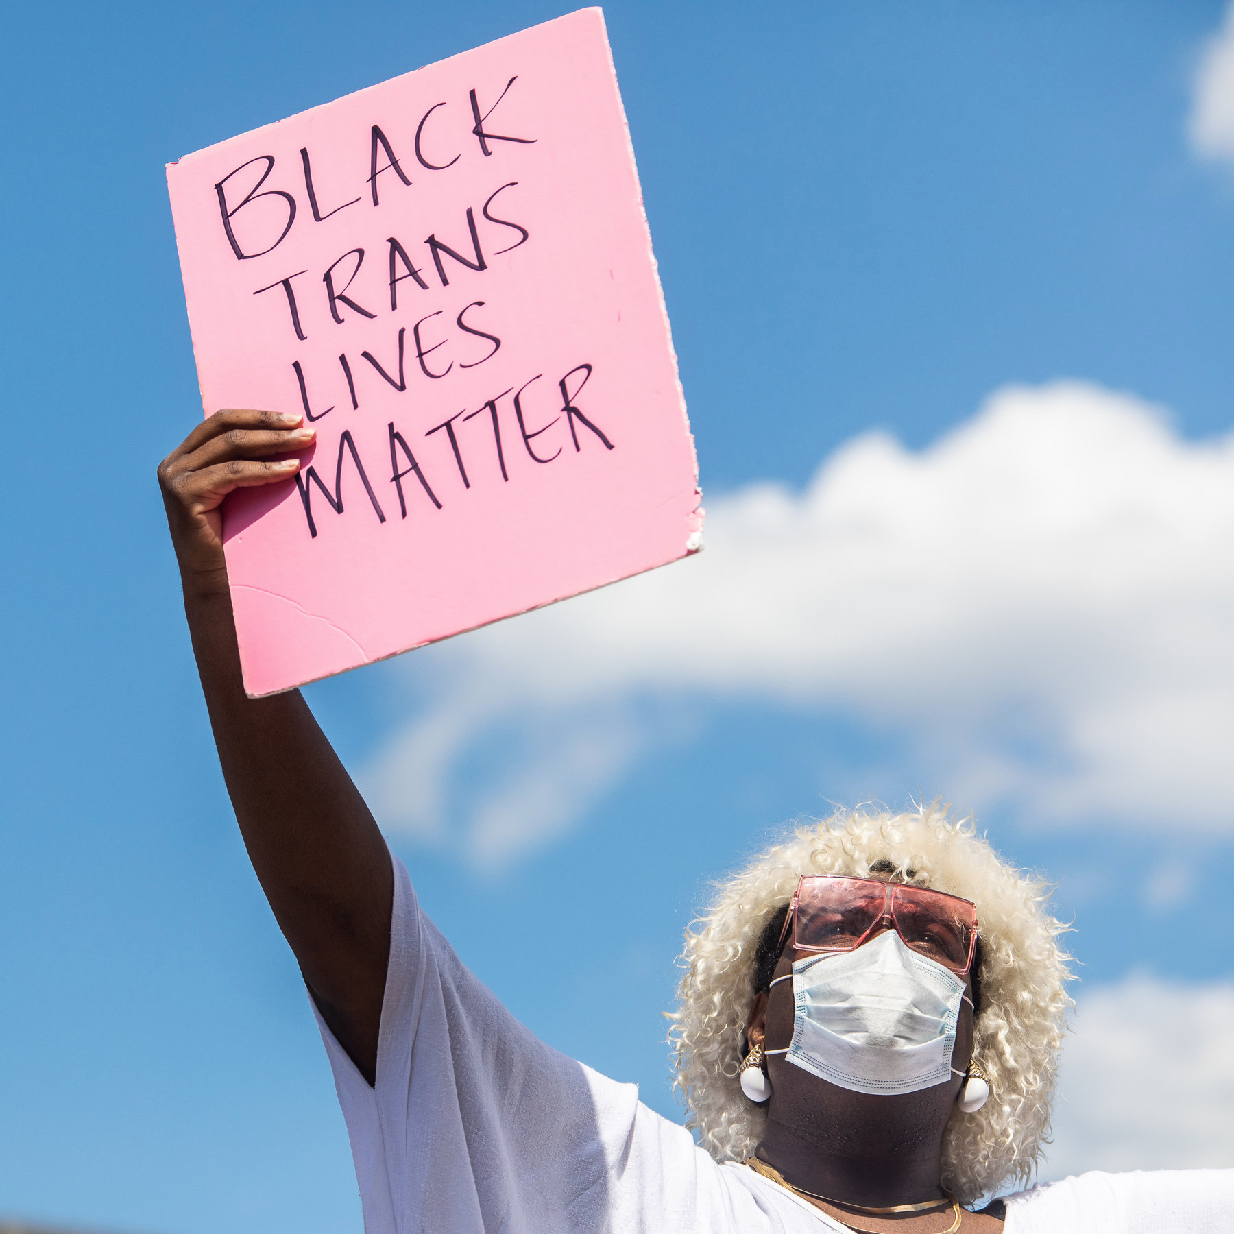
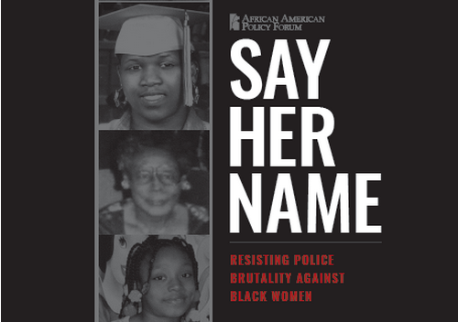
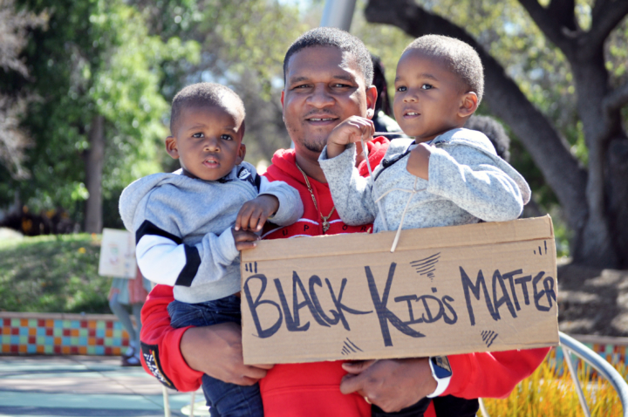
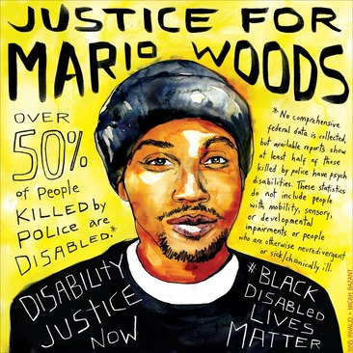

Slide 44
Misconceptions about Intersectional Stigma & Health
Myth 1:
Intersectionality is a framework developed to understand health disparities.
First articulated by Dr. Kimberlé Crenshaw within academia.
Created by and for Black feminists to articulate their (often obscured) experiences, barriers, and standpoints.
  Black feminist and womanist organizations (Combahee River Collective, 1979).
  Black women activists, ethicists, literary authors, poets, and theologians (e.g., Cannon, 1985; Collins, 1989; Davis, 1983; hooks, 1981; Lorde, 1984; Walker, 1983).
In fact, many argue that intersectionality is somewhat incongruent with contemporary (Western) academic research methods.

Slide 45
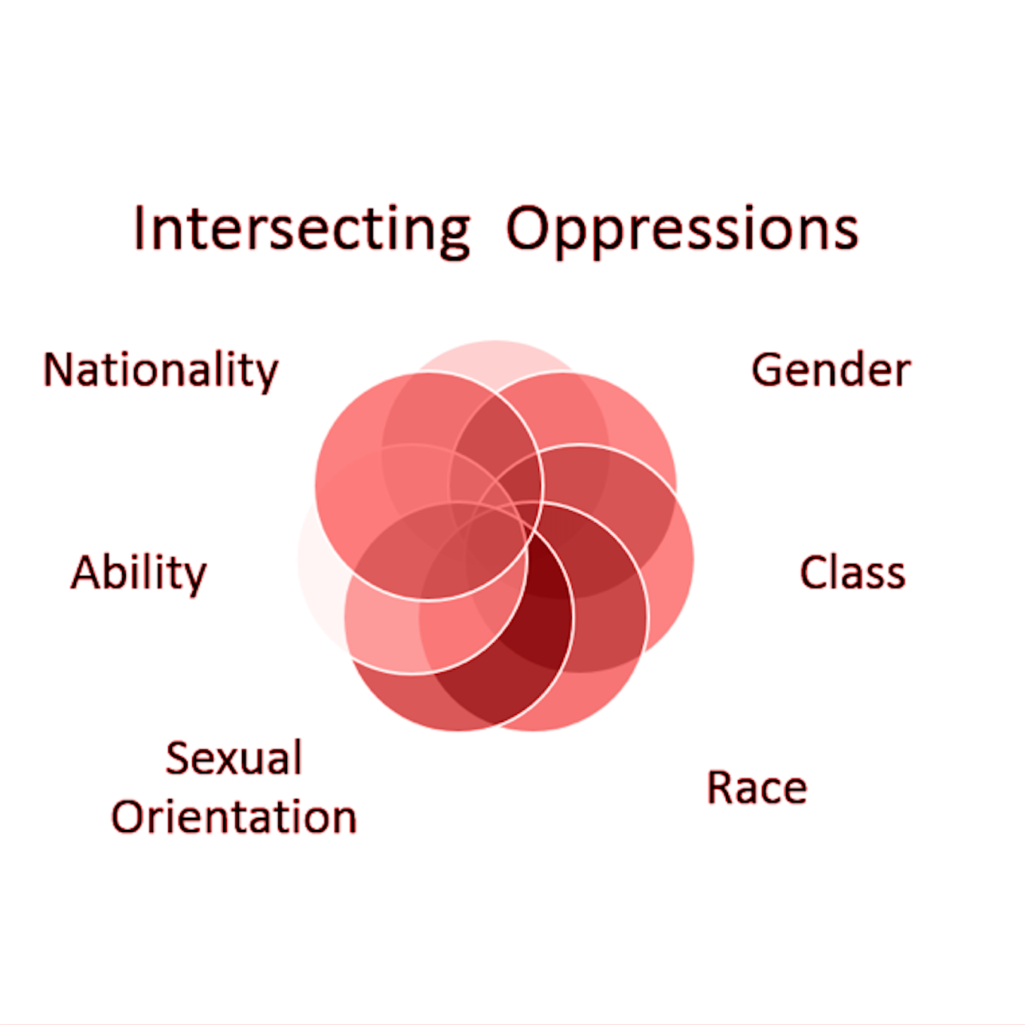
Misconceptions about Intersectional Stigma & Health
Myth 2:
Intersectionality helps health providers assess how multiple identities impact health.
Increasing emphasis on structural-level stigma in health research.
For many, it’s about the connection between macro level factors (e.g., laws/policies) and micro-level experiences (e.g., stress, sexual risk).
In short, less about identity and more social processes…

Slide 46
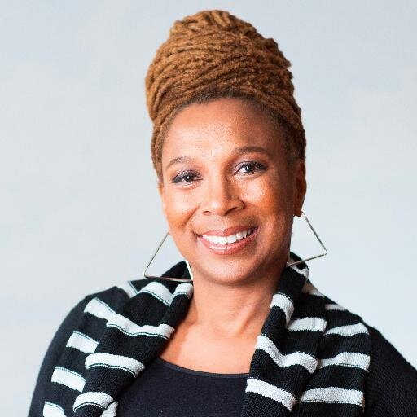
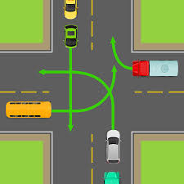
…it’s what happens in the intersections.
“Consider an analogy to traffic in an intersection, coming and going in all four directions. Discrimination, like traffic through an intersection, may flow in one direction, and it may flow in another. If an accident happens in an intersection, it can be caused by cars traveling from any number of directions and, sometimes, from all of them.”
- Crenshaw, 1989

Slide 47
Misconceptions about Intersectional Stigma & Health
Myth 3:
Intersectionality argues that individuals with more oppressed identities fair worse.
It’s more complicated than that more stigma = more strife
  e.g., past stigma, stress inoculation, and resilience
Intersectionality more of a framework than a theory
  There is no specific or overarching theory about the relations between study variables
One of many helpful metaphors
  It’s like making a cake…

Slide 48

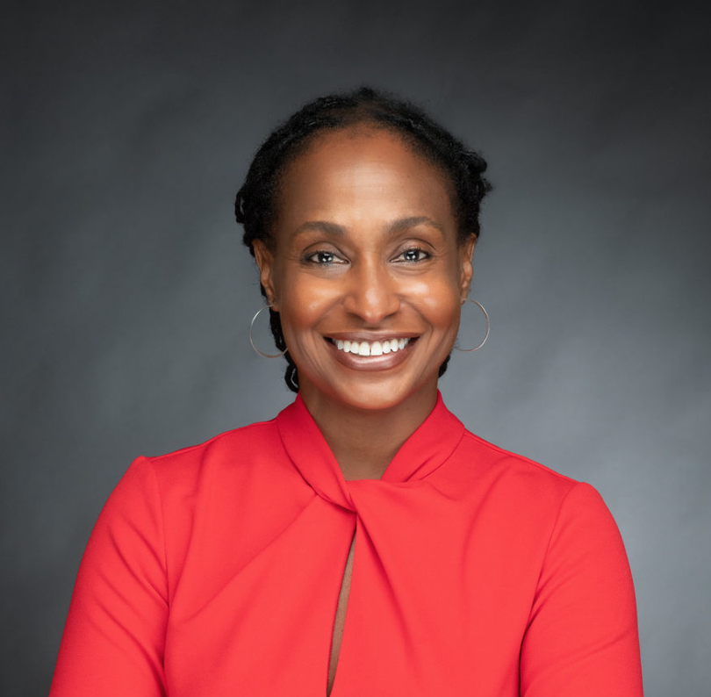
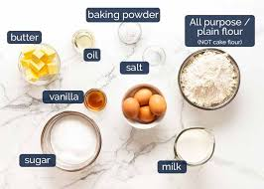
…greater than the sum of it’s parts.
Dr. Lisa Bowleg
George Washington University

Slide 49
Examining an intersection
A-D-D-R-E-S-S-I-N-G Model
Age & Generation
Developmental Disability
Disability (Acquired)
Religion
Ethnicity & Race
Socioeconomic Status
Sexual Orientation
National Origin & Language
Gender
Considering your group’s stigma (if multiple, select one)
Consider some potentially meaningful intersecting dimensions
Choose one intersection that likely produces unique challenges
  e.g., structural barriers, interpersonal stigma, or intrapersonal stress

Slide 50
Intersectionality: Common Themes
Across definitions, three common assumptions (Else-Quest & Hyde, 2016):
1. All people are characterized simultaneously by multiple social categories — categories are interconnected, co-constructed.
  2. Embedded within each of these categories is a dimension of inequality or power, which shape experience.
  3. These categories are properties of the individual and characteristics of their social; categories and their significance may be fluid and dynamic.

Slide 51
Middle Eastern
Multi-racial
Latinx
Race/Ethnicity
Asian
Black
Native
Trans
Woman
Gender Non-Binary
Gender
Gay
Lesbian
Bisexual
Sexual Orientation
Black

Slide 52
What are the common challenges or unique struggles that you believe Black/African American LGBTQ+ individuals face?

Slide 53
Part 2
Intersectional Experiences, Stigma-Related Stress, and Mental Health Among Black LGBTQ+ Individuals

Slide 54
Minority Stress Theory (Brooks, 1981; Meyer, 2003)
Among sexual minority populations, increased…
erodes
erodes
What would an intersectional versions look like…?
Distal
Stressors
Proximal Stressors
Health Outcomes
Homophobia in one’s external environment:
Anti-LGBTQ laws
Hate crimes; violence
Job discrimination
Microaggressions
Internal identity-related stress processes:
Expecting stigma
S/O concealment
Self-stigma
Mental and physical health issues:
Depression/Anxiety
Suicide risk
Substance use
Sexual compulsivity
—Race?
<
Exhaustive across
Multiple forms of stigma?
cultures?

Slide 55
Study 1.
Are there “intersectional”
forms of minority stress?
| cross-sectional; quantitative |

Slide 56
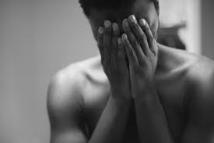
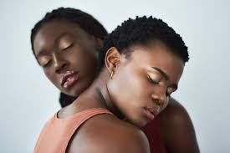
LGBTQ+ people of color | Mental health
Black LGBTQ+ people demonstrate alarming disparities…
Recent study (Layland et al. 2020) found that reporting sexual minority stress increases odds of suicide attempts regardless of race, but differentially…
  4.5x for Black sexual minorities
  but
  3.6x higher White sexual minorities
    Increased prevalence of psychiatric disorders among Black LGBTQ+ people compared with Black cisgender heterosexuals (Rodriguez-Seijas et al. 2019)
Notes:
Despite these trends, most health disparities research…
Tends to focus on one aspect of stigma in isolation from others
Thinks about stigma additively, overlooks potential for intersectionality
Lacks measures to begin to quantify and model intersectional stigma

Slide 57
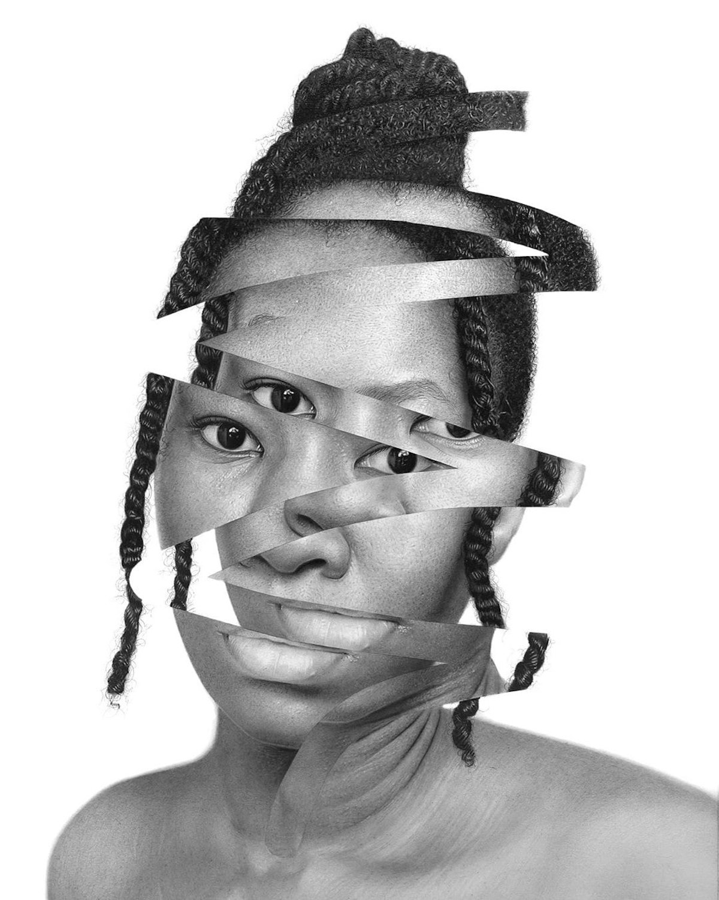
Identifying an Intersectional Proximal Stressor
Morales (1989) created 5-stage model of LGBQ racial/ethnic minority identity development.
Third stage, conflicts in allegiances – internal sense that one’s race and sexual orientation incompatible.
Although discussed in clinical/theoretical literature, but little empirical investigation.
Identity conflict may help explain explain racial/sexual disparities in mental health.

Slide 58
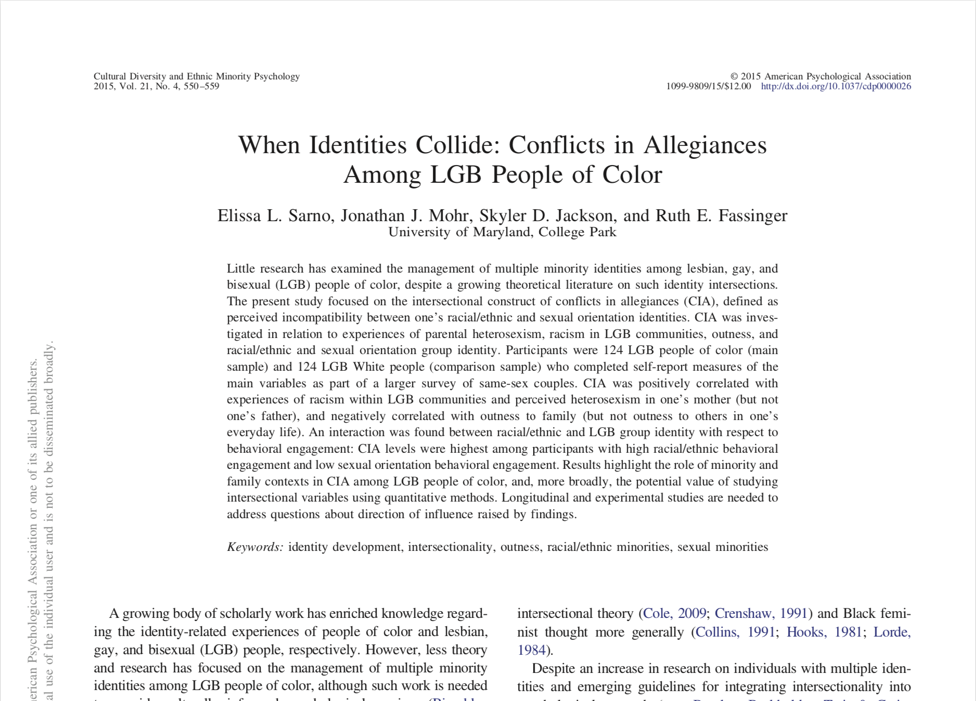
Measuring identity conflict
[intersectional proximal stressor]
Conflicts in Allegiances Scales
Disagree Agree
Strongly Strongly
1 - - - - - - - 2 - - - - - - - 3 - - - - - - - 4 - - - - - - - 5 - - - - - - - 6 - - - - - - - 7
I feel little or no conflict between my [Black] identity and my identity as LGBTQ.
I have not yet found a way to integrate being LGBTQ with being a member of my cultural group.
It is easy for me to be both LGBTQ and a member of my cultural group.
I separate my LGBTQ and [Black] identities.
I often feel like I’m betraying either the [Black] community or the LGBTQ community.
I feel as if my sense of [Black] identity is at odds with my LGBTQ identity.

Slide 59
Participants (N = 364)
Age
Ranged from 18 to 44 (M = 22.24)
Race
141 Black/African American
223 White/European American
Sexual Orientation
58 lesbian
73 gay
78 bisexual
155 heterosexual
Gender
256 women, including 5 trans women
105 men, including 7 trans men
3 did not indicate
?
Notes:
White heterosexual (n = 92)
White LGB (n = 161)
Black heterosexual (n = 117)
Black LGB (n = 50)

Slide 60
Participants (N = 364)
Age
Ranged from 18 to 44 (M = 22.24)
Race
141 Black/African American
223 White/European American
Sexual Orientation
58 lesbian
73 gay
78 bisexual
155 heterosexual
Gender
256 women, including 5 trans women
105 men, including 7 trans men
3 did not indicate
Notes:
White heterosexual (n = 92)
White LGB (n = 161)
Black heterosexual (n = 117)
Black LGB (n = 50)

Slide 61
Identity conflict
[intersectional proximal stressor]
The potential harm of identity conflict
Anxiety over betraying one community of the other
Anger from experiences of ingroup stigmatization
Shown to be associated with depression (Santos & VanDaalen, 2016)
Theorized to be triggered, in part, by an intersectional phenomenon:
INTRA-COMMUNITY STIGMA
?
Identity Conflict
Emotion Dysregulation
+
+

Slide 62
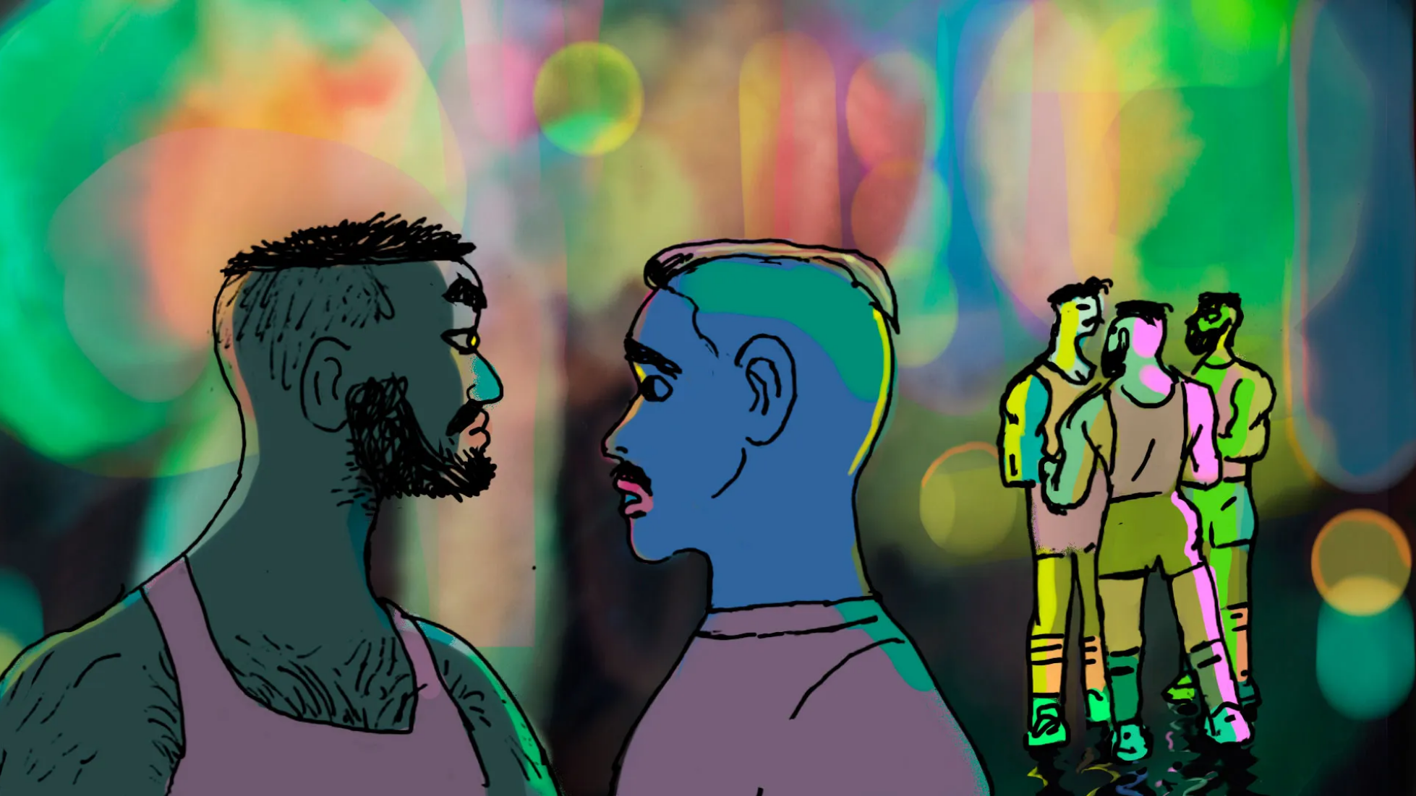
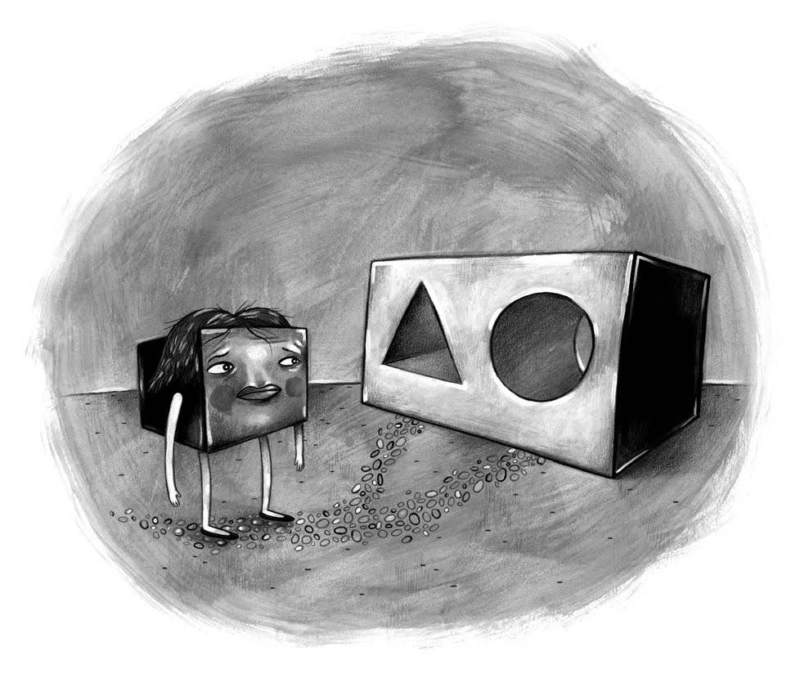
Intra-community Stigma
[intersectional distal stressor]
1. Racism within the LGBTQ community
Stereotypes, exclusion, & microaggressions
Western cultural values
Eurocentric beauty standards; Sexual objectification
2. Homophobia within one’s racial minority community
Rejection & alienation
Religious persecution
Culturally normative gender expectations

Slide 63
Black LGBQ Participants (n = 100)
Hypotheses 1 & 2: Intersectional stressors & identity conflict
Racism in LGBQ community
+
Identity
Conflict
r = .27, p = .011
Homophobia in Black community
+
Identity
Conflict
r = .38, p = .000

Slide 64
Black LGBQ Participants (n = 100)
Hypotheses 1 & 2: Intersectional stressors & identity conflict
Racism in LGBTQ community
+
Identity
Conflict
r = .27, p = .011
Homophobia in Black community
+
Identity
Conflict
r = .38, p = .000
Hypothesis 7: Intersectional supports & identity conflict
-
Black LGBTQ community involvement
Identity
Conflict
r = -.36, p = .001

Slide 65
Black LGBQ Participants (n = 100)
Note: Single-identity supports & identity conflict
LGBTQ community involvement
ns
Identity
Conflict
r = -.13, p = .235
Black community involvement
Identity
Conflict
ns
r = -.04, p = .696
Hypothesis 7: Intersectional supports & identity conflict
-
Black LGBTQ community involvement
Identity
Conflict
r = -.36, p = .001

Slide 66
Results: Raise New Questions
Are relations between negative intersectional experiences and identity conflict stable or dynamic across time?

Slide 67
Results: Raise New Questions
Are relations between negative intersectional experiences and identity conflict stable or dynamic across time?
Beyond identity conflict, do negative intersectional experiences also predict psychological health variables?

Slide 68
Results: Raise New Questions
Are relations between negative intersectional experiences and identity conflict stable or dynamic across time?
Beyond identity conflict, do negative intersectional experiences also predict psychological health variables?
Is intersectional stigma harmful above and beyond general racism or homophobia?

Slide 69
Results: Raise New Questions
Are relations between negative intersectional experiences and identity conflict stable or dynamic across time?
Beyond identity conflict, do negative intersectional experiences also predict psychological health variables?
Is intersectional stigma harmful above and beyond general racism or homophobia?
Intersectional experiences can be negative and harmful, but what about positive intersectional experiences?

Slide 70
Results: Raise New Questions
Are relations between negative intersectional experiences and identity conflict stable or dynamic across time?
Beyond identity conflict, do negative intersectional experiences also predict psychological health variables?
Is intersectional stigma harmful above and beyond general racism or homophobia?
Intersectional experiences can be negative and harmful, but what about positive intersectional experiences?
If such positive intersectional experiences exist, can they foster resilience and help reduce mental health disparities?

Slide 71
Study 2.
Do everyday intersectional
events predict ups and downs
in daily psychological health?
| microlongitudinal; mixed methods |

Slide 72
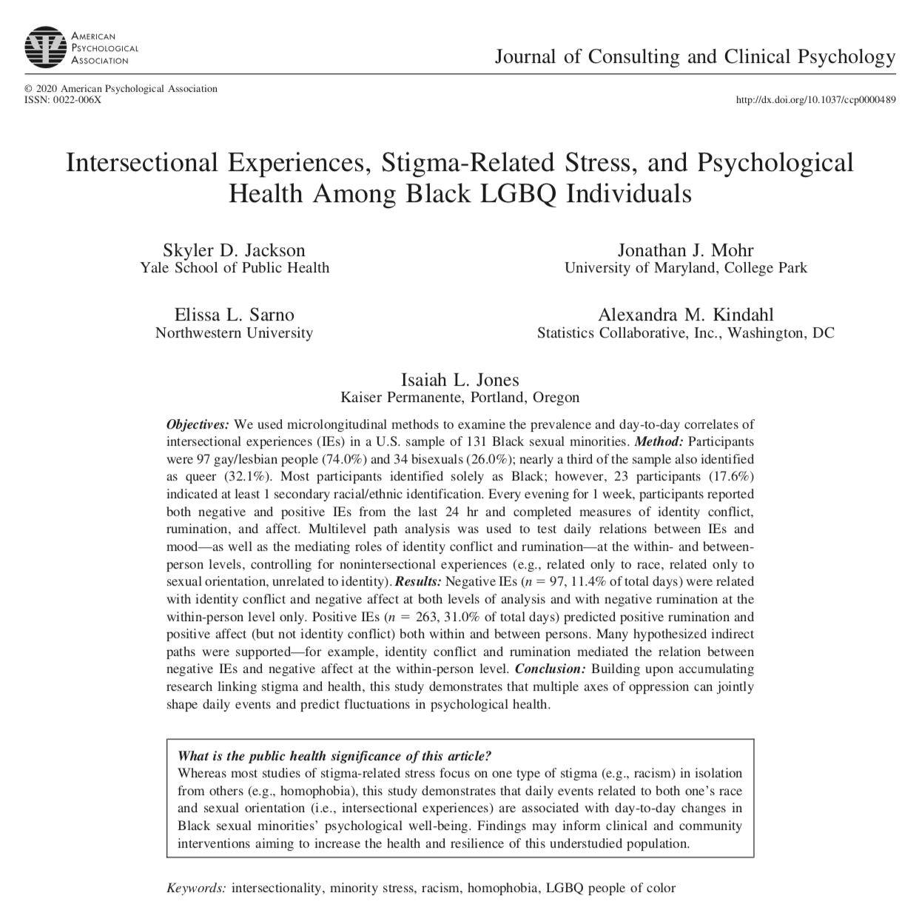

Study Aims
1. Test minority stress theory and psychological mediation framework among Black LGBQ people.
2. Examine intersectional variables that may capture unique identity-related stress processes among this population.
3. Examine the role of positive intersectional events among Black LGBQ people.
4. In addition to between-person effects, test effects over time.

Slide 73
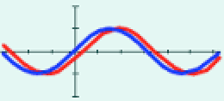
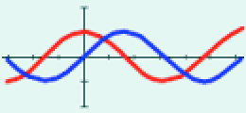
Daily Variation in Stigma-related stress
Racism (Broudy et al., 2007; Hoggard et al., 2012; O’Hara et al., 2015)
Sexism (Swim et al. 2001)
Homophobia (Mohr, 2016; Swim et al., 2009)
Shown to predict over time:
Concurrent: Stigma and health ebb and flow together
Temporal: Stigma leads to later increases in distress

Slide 74
Minority Stress Processes
Distal Events
Internal Processes
Mental Health
PROXIMAL
e.g., internalized homophobia
PROXIMAL
Stress
+
+
DISTAL
e.g., homophobic discrimination
Psychological Distress
DISTAL
Stress
+
GENERAL
e.g., rumination
+
+
Psychological Mediation Framework (Hatzenbuehler, 2009)
Direct effect
Mediation pathway

Slide 75
Minority Stress Processes
Distal Events
Internal Processes
Mental Health
PROXIMAL
e.g., internalized homophobia
PROXIMAL
Stress
+
+
DISTAL
e.g., homophobic discrimination
Psychological Distress
DISTAL
Stress
+
GENERAL
e.g., rumination
+
+
Psychological Mediation Framework (Hatzenbuehler, 2009)
Direct effect
Mediation pathway

Slide 76
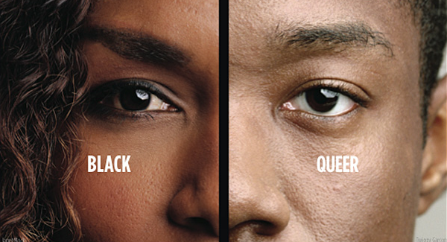
Negative Intersectional Experiences
Distal stigma-related stressors—whether smaller-scale or major life events—that arise due to one’s unique social position.
+

Slide 77
Negative Intersectional Experiences
1. Anti-Black racism within the LGBTQ+ community
2. Anti-LGBTQ+ stigma in the Black/African American community
3. Various other dynamics
Intersectional stereotypes
Invisibility
Cultural Homelessness
Tokenism

Slide 78
Minority Stress Processes
Distal Events
Internal Processes
Mental Health
PROXIMAL
e.g., internalized homophobia
PROXIMAL
Stress
+
+
DISTAL
e.g., homophobic discrimination
Psychological Distress
DISTAL
Stress
Negative Intersectional Experiences (IEs)
+
GENERAL
e.g., rumination
+
+
Direct effect
Mediation pathway

Slide 79
Daily Identity Conflict
Theorized to be triggered by (intersectional) discrimination…
Racism in LGBTQ community
Homophobia in racial/ethnic community
Theorized to increase negative affect…
Anxiety over betraying one community of the other
Anger from experiences of ingroup stigmatization
Shown to be associated with depression (Santos & VanDaalen, 2016)
Negative Intersectional Events
Identity Conflict
Negative Affect
+
+

Slide 80
Minority Stress Processes
Distal Events
Internal Processes
Mental Health
PROXIMAL
e.g., internalized homophobia
PROXIMAL
Stress
Identity
Conflict
+
+
DISTAL
e.g., homophobic discrimination
Psychological Distress
DISTAL
Stress
Negative Intersectional Experiences (IEs)
+
GENERAL
e.g., rumination
+
+
Direct effect
Mediation pathway

Slide 81
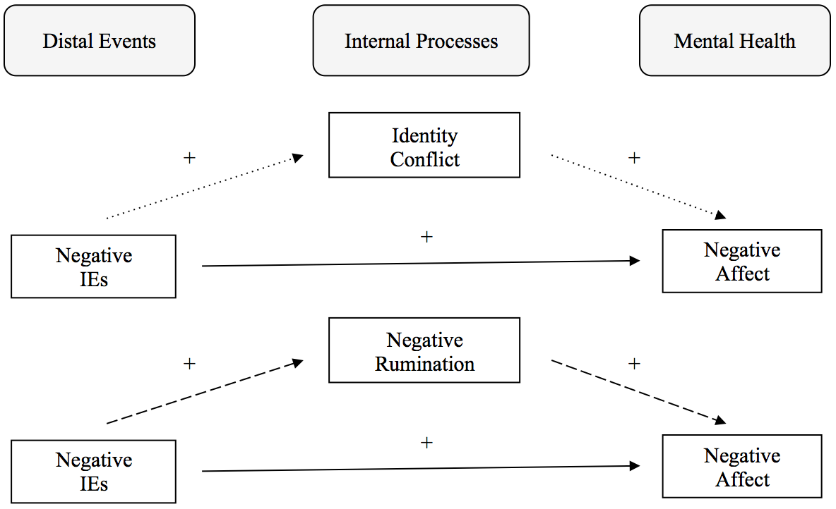
Negative Mediation Models (hypothesized)
Intersectional Identity-Related Stress
Controlling non-intersectional negative events (e.g., racism, homophobia, general)

Slide 82

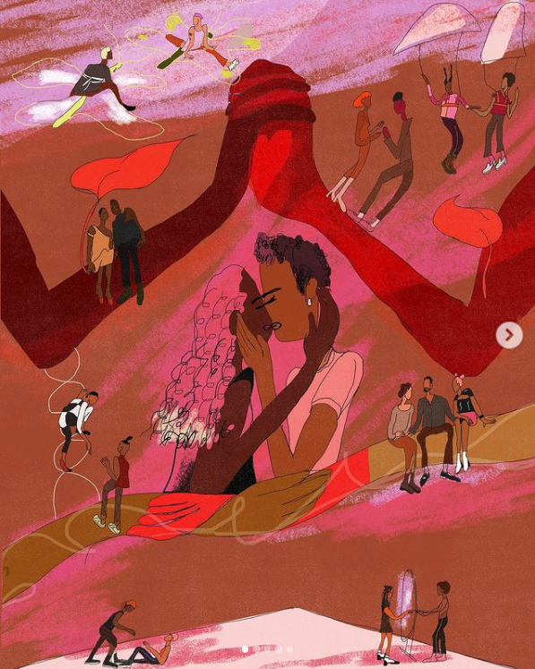

Slide 84
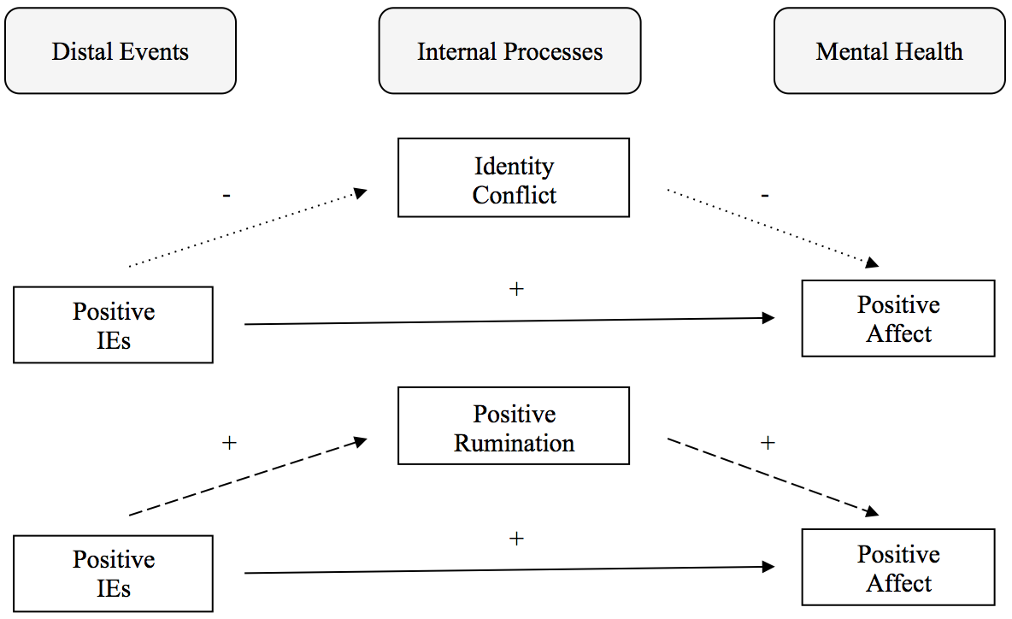
Positive Mediation Models (exploratory)
Intersectional Identity-Related Support
Controlling non-intersectional positive events (e.g., race, sexual orientation, general)

Slide 85
Methodology | Experience Sampling
What is it?
Collecting ongoing data about daily experiences
Can include quantitative and qualitative items
What are the benefits?
Reduces recall bias
Contextualizes variables of interest in everyday life
How is it used?
Allows examination at multiple levels of analysis
Can reveal direction of influence
  How we implemented it?
We sent participants daily reminders
Participants completed up to seven surveys

Slide 86
Intersectional Experiences
Construct | Measure | Details
Negative Intersectional Experiences | 3 items created for this study | Take a moment and reflect upon whether you experienced any NEGATIVE events or situations over the last 24 hours that were related in some way to being both Black and LGBQ. Consider minor, everyday experiences as well as more intense, major events. Can you think of a NEGATIVE event like this from today?
Positive Intersectional Experiences | 3 items created for this study | Take a moment and reflect upon whether you experienced any POSITIVE events or situations over the last 24 hours that were related in some way to being both Black and LGBQ. Consider minor, everyday experiences as well as more intense, major events. Can you think of a POSITIVE event like this from today?

Slide 87
An event or situation in which you experienced racial prejudice/stereotypes in the LGB community.
An event or situation in which you attempted to minimize or downplay your Black identity around non­-black LGB people (e.g., changing appearance or mannerisms, concealing interests in black music or culture).
An event or situation in which you received subtle or direct messages that all LGB people are White (e.g., from friends, family, church, the media).
An event or situation in which you felt anxious or uncomfortable during a conversation about race/ethnicity among non­-Black LGB people.
An event or situation in which you experienced homophobic prejudice/stereotypes in the Black community.
An event or situation in which you minimized or downplayed your sexual orientation around heterosexual Black people (e.g., hiding your sexual orientation, acting more masculine/feminine).
An event or situation in which you received subtle or direct messages that all Black people are heterosexual (e.g., from friends, family, church, the media).
An event or situation in which you felt anxious or uncomfortable during a conversation about sexual orientation among heterosexual Black people.
An event or situation in which you felt that you must choose between your racial identity and your sexual orientation identity or rank one identity higher than the other.
An event or situation in which you felt misunderstood, invisible, or isolated because you are both Black and LGB.

Slide 88
Negative Intersectional Events
Total study days: 849
Days with a negative intersectional event: 97 (11.4%)
“I'm in a dance class and in order to get to my dance class I have to walk through the gym. Today the basketball team was practicing and when they saw me heading to class they made very crude [homophobic] comments. They were black. And I'm sure I can shoot baskets around them.”
After work I decided to stop by a bar […] in the "Gayborhood" […] and hung around for a bit when I realized that I was being pretty much completely ignored. I felt invisible and undesirable in a bar consisting of mostly cis-gender white gay males. This wasn’t the first time I'd felt this way, but I always hope that it will be different.”

Slide 89
Modeling Stigma-related Stress
Distal Events
Internal Processes
Mental Health
Identity
Conflict
+
+
Negative Intersectional Events
Negative
Affect
+
Within-person indirect effect | Mediation Significant
Notes:
Results figure 1

Slide 90
Modeling Stigma-related Stress
Distal Events
Internal Processes
Mental Health
Negative Rumination
+
+
Negative Intersectional Events
Negative
Affect
+
Within-person indirect effect | Mediation Significant
Notes:
Results figure 2

Slide 91
Positive Intersectional Events
Total study days: 849
Days with a negative intersectional event: 97 (11.4%)
Days with a positive intersectional event: 263 (31.0%)
“I was just very proud to discuss the intersectionality of the experiences of black and LGBT people. I had this conversation with my grandmother […] about her gay friends’ experiences in the 1960s and 1970s in New York and New Jersey.”
“I have recently started talking to another Black girl who is bisexual. I'm very happy we are interested in each other […]. I have issues dating white women (not sure if they're racist) and many Black women I know are not queer, so my dating pool tends to be limited. But this gives me hope.”

Slide 92
Complex Intersectional Events
“An appointment with my doctor started with me having a long wait in a cramped receptionist room with all Black patients. While waiting, there was a TV program about marriage equity that prompted one patient to make homophobic statements about same-gender marriages and relationships in general.
I opened my mouth to counter her comments, but several persons beat me to it and read her up one side and down the other. The discussion continued after the homophobic person went in to see the doctor and I was able to participate in the discussion with lots of affirmation about marriage equity.”
– Bisexual male, age 71

Slide 93
Modeling Stigma-related Support
Distal Events
Internal Processes
Mental Health
Identity
Conflict
ns
ns
Positive Intersectional Events
Positive
Affect
+
Within-person indirect effect | Mediation Not Significant
Notes:
Results figure 3

Slide 94
Modeling Stigma-related Support
Distal Events
Internal Processes
Mental Health
Positive Rumination
+
+
Positive Intersectional Events
Positive
Affect
ns
Within-person indirect effect | Mediation Significant
Notes:
Results figure 4

Slide 95
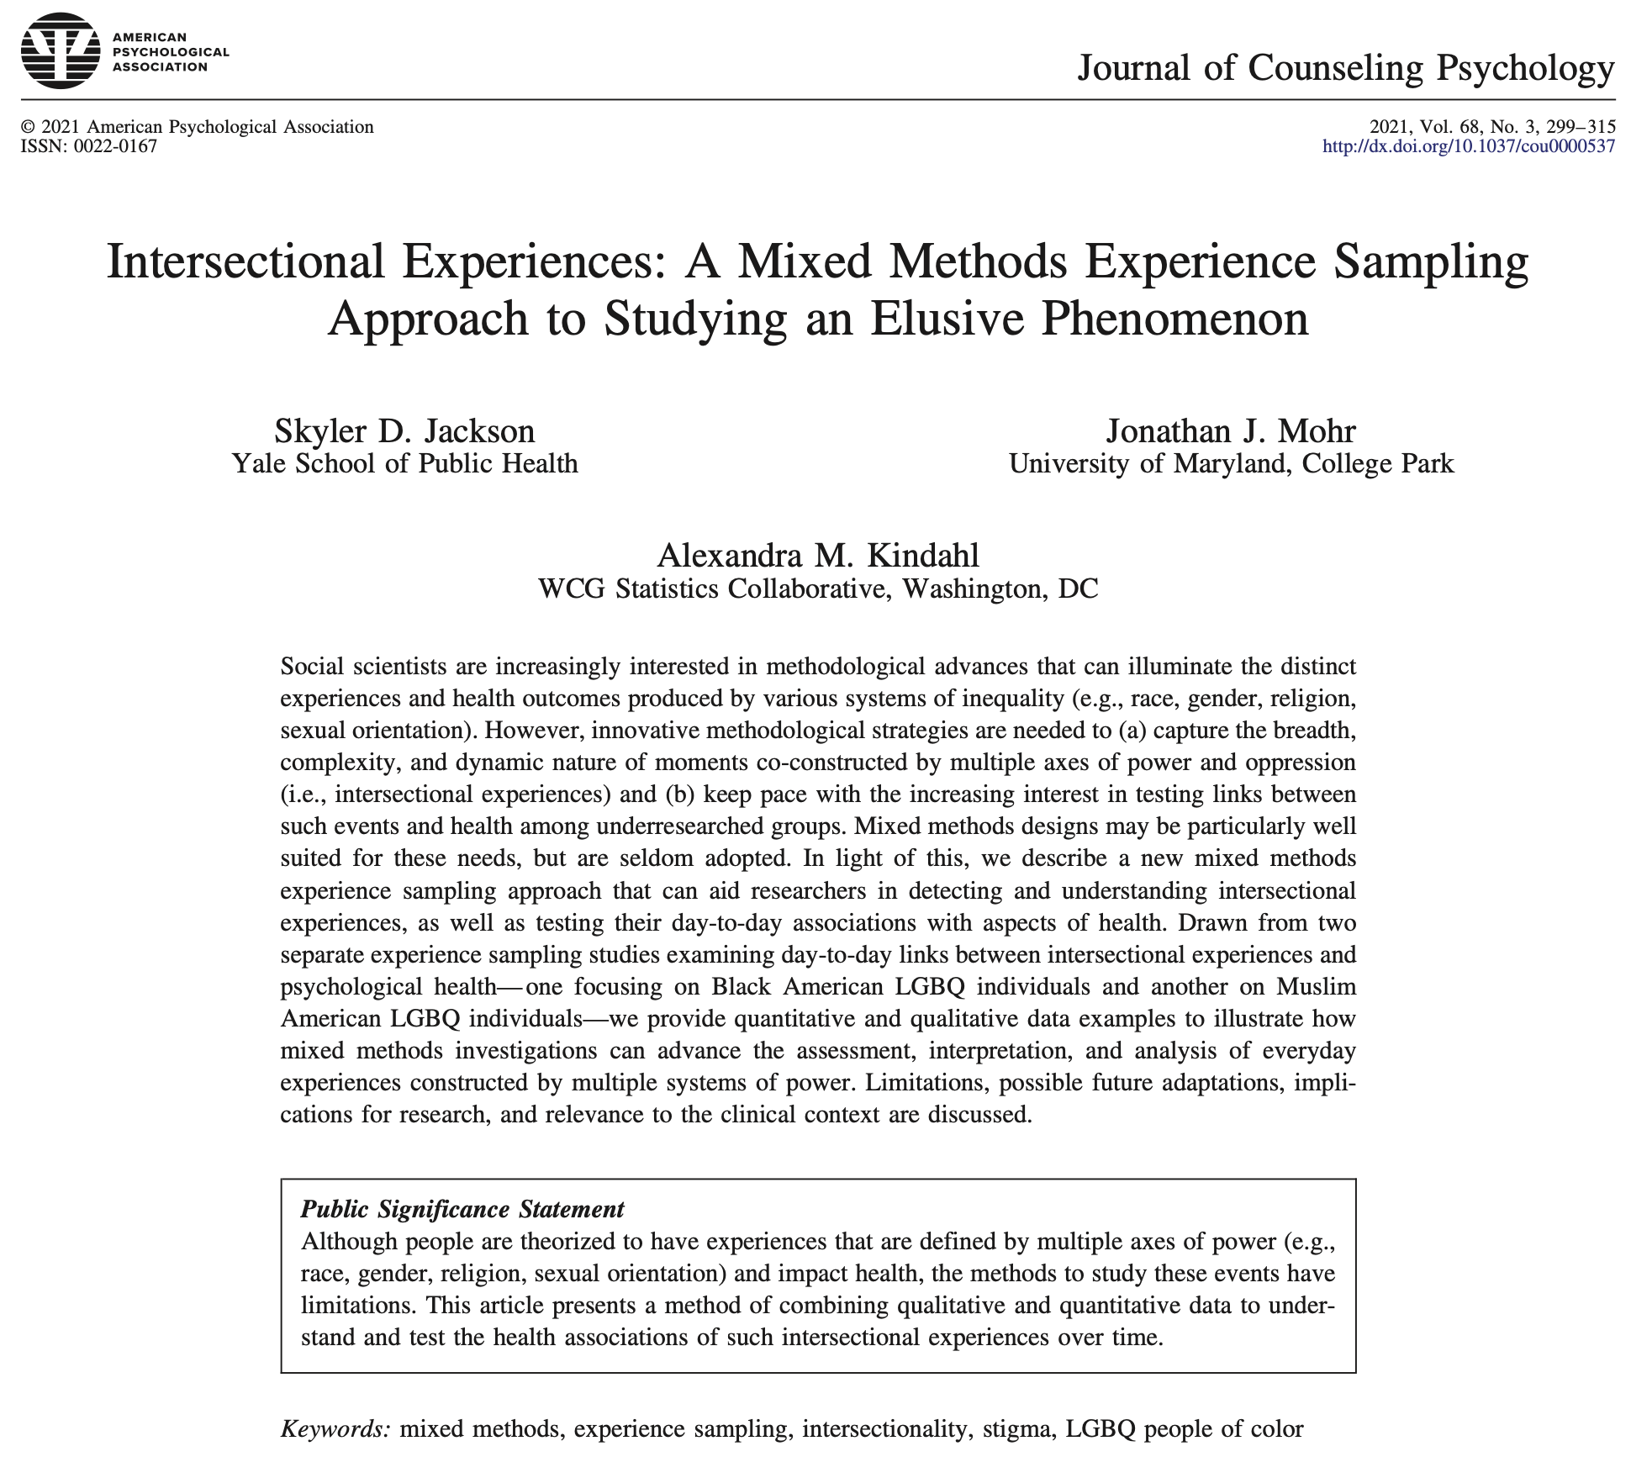
Jackson et al. (2021)

Slide 96
Poll 4. How equipped do you feel to assess and address the unique issues and barriers of Black LGBTQ+ people?
Not at all equipped
Somewhat equipped
Mostly equipped
Totally equipped

Slide 97
Very few people get training in how to help Black LGBTQ+ patients navigate these issues.
What considerations and strategies have helped you with them?

Slide 98
Stigma & Therapy: Three shifts
MINORITY POPULATIONS & MENTAL HEALTH
  Driven by pathology → Driven by environmental stressors
CONCEPTUALIZING IDENTITY & DIFFERENCE
  Single-identity → Multiple identities → Intersectionality
TRAINING GOALS
  Cultural competency (content) + Cultural humility (process)

Slide 99
Competence + Humility?
CULTURAL COMPETENCE
Goal: To build an understanding of various marginalized populations to better and more appropriately provide culturally-relevant services
Skills: Knowledge; Training; Expertise
Stance: Primary prevention
Challenge: No one size fits all; Can lead to stereotypes; Never ending
CULTURAL HUMILITY
Goal: To intentionally rely upon facilitate personal reflection and real-time around culture in order to increase psychotherapists ability to handle culturally-relevant moments in treatment
Skills: Introspection; Curiosity; Co-learning; Flexibility
Stance: Secondary prevention
Challenge: Public learning; Disrupts expert status; Never ending

Slide 100
Skill: Invitation to (dis)identify
A way of inviting information about identity/intersectional experiences…
Step 1: Depersonalize
  to acknowledge you don’t know their experience
  to give them full agency to define their experience
Step 2: Anchor with opposite experiences/perspectives
  to reduce pressure, avoid stereotyping, and normalize
  you’ve got to sell it
Step 3: Leave open-ended
  to invite details
  to reflect curiosity
“…I know some [insert group] [insert cultural competence about group experience, challenge, struggle], whereas other [insert opposite experience]. What’s it like for you?”

Slide 101
Examples
Use Cultural Competency: Gay men with physical disabilities often report experiencing ableism and rejection in the LGBT community
Inquire with Cultural Humility: I know some gay men with physical disabilities report experiencing ableism and rejection in appearance-focused segments of the LGBT community, whereas others feel very accepted among other LGBT people. What’s your experience been?
Use Cultural Competency: Older women face sexist beauty standards that are based on youthfulness
Inquire with Cultural Humility: Some of my female clients have started to feel invisible or less womanly as they age because society focuses so much on women’s appearance and how youthful they look, but other aging female clients don’t report this—they really enjoy getting older. What is your relationship with aging?
Use Cultural Competency: Many Black women are viewed as the “angry Black women” when they assert themselves
Inquire with Cultural Humility: I know some Black women feel that they are often viewed as the “angry Black women” whenever they assert themselves, whereas other Black women don’t experience that stereotype. What’s it like for you?

Slide 102
Examples for improvement
Cultural Competency: Some LGBT Muslims view their sexual orientation and religion as incompatible
I remember you saying you aren’t out to your family and I know many LGBT Muslims tend to keep their sexual orientation and religious identities separate. That said, I also know that others don’t see them as incompatible. How does this play out for you?
Corrected: I know some LGBT Muslims tend to keep their sexual orientation and religious identities separate, but I also know that others don’t see them as incompatible. How does this play out for you?
Cultural Competency: Multiracial women are at risk for being exoticized and objectified
I know some Multiracial women may be seen as exotic, which for some women feels positive, but for others can feel negative. Has this ever happened to you?
Corrected: I know some Multiracial women may be seen as exotic, which for some women feels positive, but for others can feel negative. How does this fit into your experience?
Use Cultural Competency: Trans women can experience “identity invalidation” (e.g., people saying they aren’t “real women”)
I know some trans women experience identity invalidation—like people saying or implying they aren’t “real women”. How has your experience been with this?
Corrected: I know some trans women experience identity invalidation—like people saying or implying they aren’t “real women”—but I also know that isn’t everyone’s experience. How has your experience been with this?

Slide 103
Part 3
Promoting Black LGBTQ+ Health and Well-Being: From Intersectional Interventions to Clinical Attitudes

Slide 104
Results: Raise New Questions
Can we intervene to help people better cope with multiple, intersecting forms of stigma and improve mental health?

Slide 105
Results: Raise New Questions
Can we intervene to help people better cope with upon multiple, intersecting forms of stigma and improve mental health?
Can we bolster positive intersectional experiences (e.g., access to intersectionally-informed treatment, access to similar others) to address health disparities?

Slide 106
Results: Raise New Questions
Can we intervene to help people better cope with upon multiple, intersecting forms of stigma and improve mental health?
Can we bolster positive intersectional experiences (e.g., access to intersectionally-informed treatment, access to similar others) to further support mental health outcomes?
Since mental and sexual health co-occur, might such an intervention address HIV transmission disparities among a high-risk, multiply marginalized populations?

Slide 107
Study 3.
Can a group treatment address
intersectional stigma, mental
health, and HIV risk?
| open trial; intervention research |

Slide 108
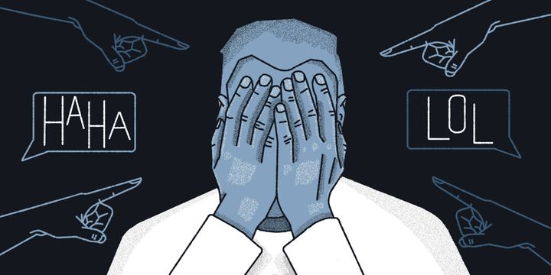
Stigma and Health Outcomes
Perceived discrimination predicts health (Pascoe & Smart Richman, 2009)
  ⬇ Physical health (e.g., hypertension, breast cancer, HIV disease progression)
  ⬇ Mental health (e.g., depression, anxiety, psychological distress, well-being)
  ⬆ Disease risk factors (e.g., obesity, high blood pressure, substance use)
  ⬆ Physiological responses (e.g., heart rate, cortisol secretions)

Slide 109
How does anti-LGBTQ+ stigma get under the skin?
Identity-Related Stressors
Anxious Expectation of Stigma
Internalized anti-LGBTQ stigma
Concealment / Disclosure Stress
Universal Risks
Rumination
Social Isolation
Emotion dysregulation
Stigma
(e.g., structural stigma, interpersonal stigma)
Depression
Anxiety
Substance Use
HIV Risk
Pachankis (2014). Clinical Psychology: Science and Practice

Slide 110
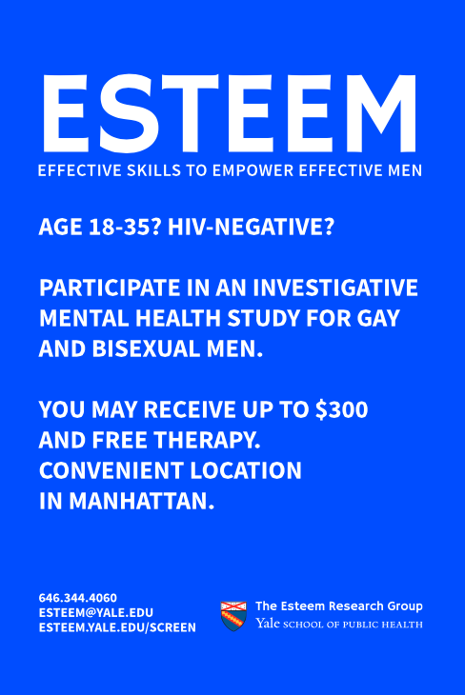
Transdiagnostic LGBTQ+ minority stress treatment
Created for and by LGBTQ+ people
Based on Unified Protocol’s CBT principles
Safe space to problems/distress associated with minority stressors
10 one-on-one psychotherapy sessions (50-60 minutes)
Weekly home practice

Slide 111

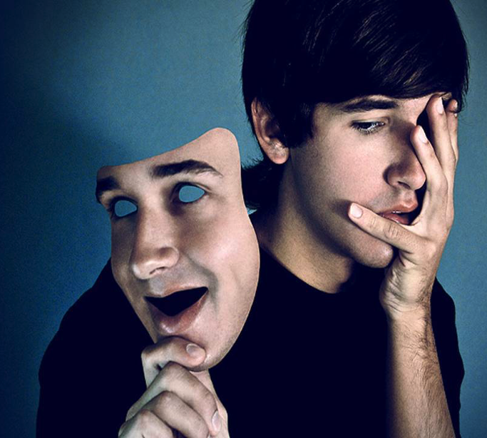
Manifestations of Minority Stress
Cognitive
Internalizing stereotypes about LGBTQ people as inferior or weak, unlovable
Not believing in one’s ability to form genuine, intimate relationships outside of a purely sexual domain
Affective
Anxiously being on the lookout for rejection
Fear of being discovered or outed as LGBTQ+
Behavioral
Silencing one’s own needs or self-expression out of shame
Hiding one’s identities or behaviors, at the cost of close relationships and psychological integrity

Slide 112
Consciousness
Raising
Reduce
Emotional
Avoidance
Self-Assertion
Training
Cognitive
Restructuring
Find Supportive
Community
What if we could intervene here to help people better cope with stigma?
Identity-Related Stressors
Hyper-vigilance
Internalized stigma
Identity concealment
Universal Risks
Rumination
Social Isolation
Emotion dysregulation
Stigma
(e.g., structural stigma, interpersonal stigma)
Depression
Anxiety
Substance Use
HIV Risk
Pachankis (2014). Clinical Psychology: Science and Practice

Slide 113
The ESTEEM Program (Pachankis et al. 2015)

Slide 114
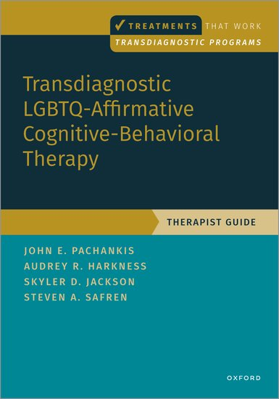
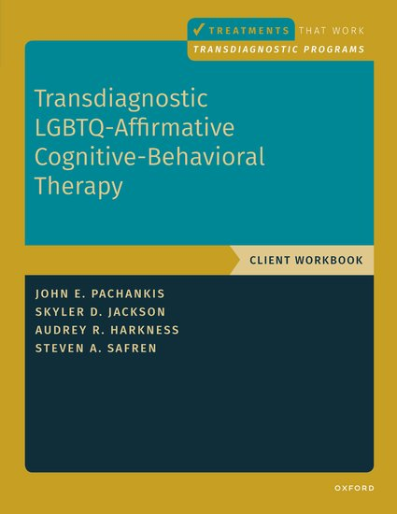
LGBTQ-affirmative CBT
(published summer 2022)

Slide 115
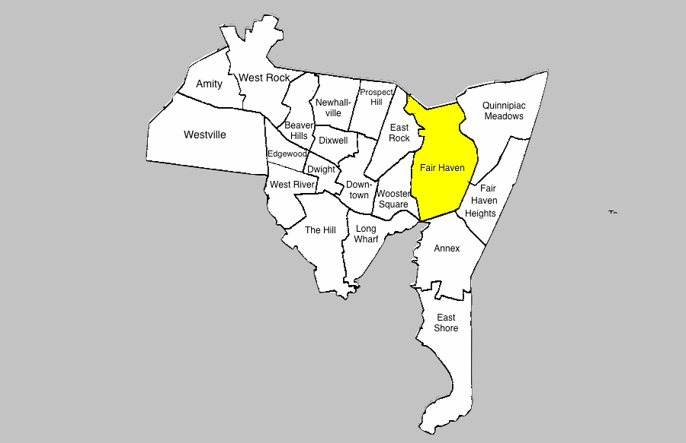
Community Need: Fair Haven

Slide 116
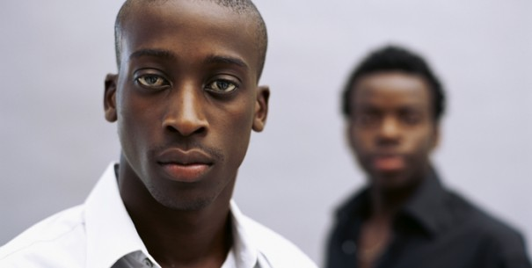
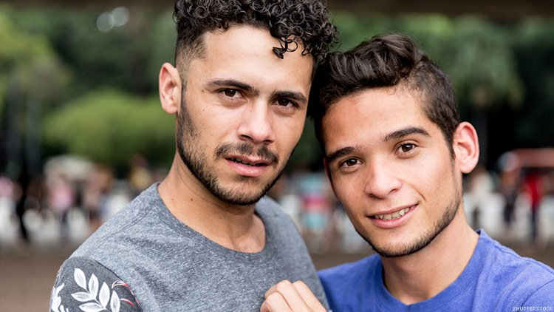
Young GBM of color | HIV disparities
  The burden of HIV is far from equally distributed in US
  Predicted by demographic factors (e.g., age, race, gender, sexual orientation)
  At the nexus: Young Black and Latinx GBM in high risk geographies
  1 in 2 Black GBM; 1 in 4 Latinx GBM
  4x rate for White GBM
  40x rate of all men
  Driven by greater sexual risk behaviors?
  Research doesn’t support this
  Attributed to structural racism and interpersonal stigma
  As long as such barriers exist, stigma-coping treatments are needed

Slide 117
Adaptations to ESTEEM treatment
1. Address additional forms of stigma-related stress
  e.g., racism, intersectionality
2. Integrate issues relevant to small urban areas
  e.g., lack of gay community spaces, low community visibility
3. Shift to group-based delivery
  e.g., restricted social networks, lack of healthy role models

Slide 118
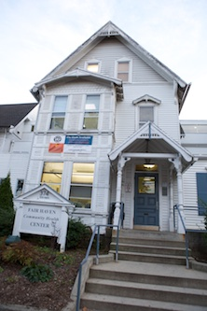
ESTEEM-conneCT Pilot
Eligibility criteria
Age: 18-35
Gender: Men
Race: Latino and/or Black
Sexual Orientation: Gay, bisexual, or MSM
Location
Fair Haven Community Health Care
Group Therapists
1 Black sexual minority male (Cohort 1)
1 Latinx sexual minority male (Cohort 2)

Slide 119
Participant Demographics (N=21)
Age
4 age 18-23 (19.05%)
11 age 24-29 (52.38%)
6 age 30-35 (28.57%)
Sexual Identity
16 Gay
3 Bisexual
2 Queer
Race/Ethnicity
7 Hispanic/Latinx (33.33%)
5 Hispanic/White (23.81%)
5 Black/Hispanic (23.81%)
4 Black/Non-Hispanic (19.05%)
Gender Identity
20 cisgender men
1 FtM transgender man
Income
10 less than $10,000 (47.62%)
2 $10,000 - $19,999 (9.52%)
2 $20,000 - $29,999 (9.52%)
3 $30,000 - $39,999 (14.29%)
3 $40,000 - $49,999 (14.29%)
1 $50,000 - $74,999 (4.76%)
HIV Status
19 Negative (89.5%)
2 Positive (10.5%)

Slide 120
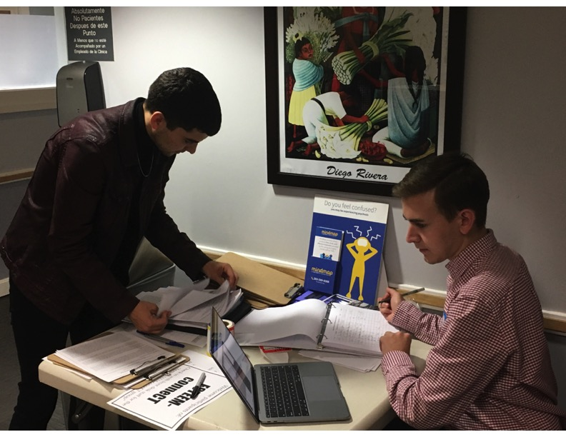

Data collection
Measures pre- and post-intervention (3-mo)
  Stigma coping
  Mental health
  Sexual risk
Feasibility Data
  Eligibility-Enrollment Ratio
  Sessions completed
  Reasons for absences
  Rate of retention
Exit interviews
  Perceived change in above areas
  Acceptability of specific components
  Additional feedback for refinement
YSPH MPH Student Research Assistants

Slide 121

Impact | Sexual Orientation Stigma
“[…] being in that group circle, I noticed a lot of the things that I was taught was incorrect, and […] helped me to let go of those like homophobic racist tendencies. […] I used to think that being gay was a bad thing, and I used to think that I should be ashamed of myself, that I should try and be straight, and that I shouldn’t hang out with like other gay people, and yeah, now it’s like the exact opposite […] like a whole 180. [...] I loved it and it helped me a lot with like my internalized homophobia.”

Slide 122

Impact | Racial Stigma
“You guys showed me to be proud, strong, and stand for who we are. I was a little ashamed, I’m a Latin male and especially with Trump in the realm and Republicans and the topic on Mexicans. […] We have to show we’re people—we have pride, we can persevere […].”

Slide 123

Impact | Intersectional Stigma
“It really did help me cope with the reality that I am LGBT and I am a person of color. […] I'm a minority of minorities. […] The study made me […] feel more comfortable in a way, because I saw the others that were there that were also people of color. It just made me feel more comfortable with myself.”

Slide 124

Impact | “I am not alone”
“I was talking about […] homophobia, since my family like they’re very, very bigoted, and like homophobic and racist, and all of that. I got the perspective of other Latino men […] they would say that oh, they were raised the exact same way […] it made me feel like I wasn’t alone. [Another participant] spoke about stuff that he had to deal with in the past […] his family [...] hearing them talk about it in the group sessions was like really valuable to me.”

Slide 125
Stigma Coping (N=21)
Variable | Pre | 3-mo Post | ES | Change
Sexual Minority Stressors
Sexual orientation rejection sensitivity | 10.73 (5.66) | 9.92 (5.97) | .14 | ✓
Sexual orientation concealment | 2.15 (0.97) | 2.01 (0.95) | .15 | ✓
Internalized homophobia | 1.53 (0.68) | 1.53 (0.78) | .00 | ---
Racial Minority Stressors
Race-related anticipatory stress | 5.26 (1.05) | 5.00 (1.39) | .21 | ✓
Race-related rumination | 3.37 (1.54) | 3.06 (1.50) | .21 | ✓
Race-related vigilance | 3.29 (1.39) | 3.24 (1.30) | .04 | ✓
Intersectional Stressors
Homophobia in racial community | 1.94 (1.70) | 1.82 (1.50) | .07 | ✓
Racism in LGBT community | 2.02 (1.49) | 1.99 (1.49) | .02 | ✓
Racism in close LGBT relationships | 2.29 (1.56) | 1.95 (1.53) | .22 | ✓

Slide 126
Mental & Sexual Health (N=21)
Variable | Pre | 3-mo Post | ES | Change
Mental Health Outcomes
Depressive | 22.10 (11.89) | 20.35 (12.01) | .15 | ✓
Anxiety | 12.05 (3.54) | 11.88 (6.07) | .03 | ✓
Psychological distress | 2.12 (0.87) | 2.05 (1.03) | .07 | ✓
Suicidal ideation | 4.33 (9.63) | 3.41 (8.20) | .10 | ✓
Alcohol use | 16.90 (6.57) | 17.53 (8.77) | .08 | ---
Sexual Health Outcomes
Condom use self-efficacy | 48.05 (16.33) | 49.24 (14.32) | .08 | ✓
Sexual compulsivity | 18.38 (7.11) | 18.18 (8.89) | .03 | ✓
Recent PrEP use | 0.31 (0.48) | 0.33 (0.49) | .04 | ✓
Recent HIV risk acts (baseline risk group) | 13.67 (15.24) | 12.67 (11.84) | .07 | ✓

Slide 127


Theoretical Model of Intersectional Stigma Related Stress among GBM of color
(Jackson et al., 2022)

Slide 128



Slide 129


Research Aims
Aim 1. Examine structural racism, structural homophobia, and their intersection as drivers of mental health and HIV risk among Black and Latino gay and bisexual men (GBM).
Aim 2. Execute a community-engaged adaptation of an existing EBI (ESTEEM) to increase its cultural and geographic relevance to Southern Black and Latinx GBM.
Aim 3. Conduct an open trail pilot of an intersectional, culturally-responsive health intervention for young Southern Black and Latinx GBM (n = 30; across two cohorts).

Slide 130
Acknowledgements
Collaborators
Kriti Behari, MA
Cindy J Chang, PsyM *
Eddie SW Chong, PhD *
Tyler D Harvey, MPH *
Jackson Higgenbottom, MPH *
Isaiah L Jones, MSW *
Colleen A Kase, MS *
Alexandra M Kindahl, BA *
Charlotte Loopuijt *
Erin McConocha, MPH
Jonathan J Mohr, PhD
Jillian R Scheer, PhD
Elissa L Sarno, PhD *
Cesar Villarreal, PhD
Krystn R Wagner, MD, PhD
Mike Yepes, MPH *
N
IH K01 Mentors
Lisa Bowleg, PhD
Dustin T Duncan, ScD
Mark L Hatzenbuehler, PhD
John E Pachankis, PhD
NIH K01 Consultants
Lauren Brown, PhD, LCSW
Danya Keene, PhD
Sten Vermund, PhD
Community Partners
CenterLink
Nashville CARES
Fair Haven Community Health Care
* Denotes collaborator was a student or mentee at the time of contribution

Slide 131
Acknowledgements (continued)
NIMH K01 Award
1K01MH122316-01A1
National Institute of Health
Loan Repayment Program
National Institute of Health
LGBTQ Mental Health Resource Fund
David R. Kessler, M.D. '55
Dean’s Research Initiative
UMD College of Behavioral and Social Sciences
Yale AIDS Prevention Training Program
Center for Interdisciplinary Research on AIDS
Pilot Projects in HIV/AIDS Research
NIMH parent award, Center for Interdisciplinary Research on AIDS
Fund for Lesbian and Gay Studies
Yale LGBT Studies Program
George M. Phillips Award
UMD College of Behavioral and
Social Sciences

Slide 132
Activity
Forced Choice

Slide 133
During this silent activity, you will be read a series of statements.
You will be asked to reflect on and respond to each statement with the answer best represents your response.
This activity will be directly followed by a brief discussion.

Slide 134
Poll 5. Which answer best reflects your response to this statement?
Strongly agree
Agree
Disagree
Strongly disagree

Slide 135
Overall, I feel prepared to intervene if a Black/African American client comes to me with very negative views of themselves because they are LGBTQ+.

Slide 136
The idea of discussing sexual orientation or gender identity in therapy with Black clients makes me nervous or uncomfortable because it is such a controversial issue in the Black community.

Slide 137
I rarely think about the issue of sexual orientation.

Slide 138
I generally assume my Black/African American patients are heterosexual, unless I know otherwise.

Slide 139
It is sometimes difficult to reconcile my religious beliefs with my desire to be inclusive of LGBTQ+ patients.

Slide 140
Sometimes I worry that, by training to be inclusive of LGBTQ+ clients (e.g., assessing sexual orientation and gender identity during clinical assessments), I might offend, confuse, or alienate some of my non-LGBTQ+ clients.

Slide 141
For the most part, I would feel comfortable if some of my Black/African American patients weren’t sure if I were gay or not.

Slide 142
I’m confident a patient of mine would feel comfortable with me knowing they were LGBTQ+ or were questioning their sexual orientation or gender identity.

Slide 143
I’m confident a patient of mine would tell me if they were struggling with their sexual orientation or gender identity.

Slide 144
I believe there is an age-appropriate way to discuss this form of diversity with Black/African American patients of nearly any age.

Slide 145
I think that most of the parents of my child patients would disapprove me having affirming discussions regarding their child’s sexual orientation or gender identity.

Slide 146
My place of work has taken tangible action to ensure it is safe, inclusive, and affirming for Black LGBTQ+ patients.

Slide 147
Sexual and gender diversity is visible within the physical space in which I work (e.g., gay-friendly posters, LGBTQ+ pride flag, etc.).

Slide 148
I have strong personal views about LGBTQ+ issues.

Slide 149
Thank you for reflecting

Slide 150
Today’s Learning Objectives
You now should be able to…
Articulate the dominant theory explaining the mental health disparities between LGBTQ+ people and their cisgender/heterosexual counterparts.
Rank how the mental health of Black LGBTQ+ individuals compares to their Black cisgender and heterosexual counterparts.
Distinguish between distal LGBTQ+ minority stressors and proximal LGBTQ+ minority stressors.
Identify the two dominant forms of intracommunity stigma that shape the lives of Black LGBTQ+ people.
Recall three studies that incorporate intersectional theory to study the behavioral health of Black LGBTQ+ people.
Provide an example of how intersectionality can be applied an evidence-based treatment to address the unique needs of Black LGBTQ+ people.

Slide 151
BETWEEN A ROCK
• • •
and a hard place
Intersectional experiences, stigma-related stress, and behavioral health among Black LGBTQ+ individuals
Skyler Jackson, PhD
Assistant Professor (he/him)
Department of Social and Behavioral Sciences
Yale School of Public Health
Pathways to Wellness
African American Training & Tech Assistance Program
Presented December 1, 2023

Slide 152
Drawing Outside of the Lines
Gender
Race/
Sexual
Identity
ethnicity
Orientation
Cisgender Woman | Asian | Lesbian
Intersex | Black | Gay
Gender non-binary | Multiracial | Bisexual/Pansexual
Genderqueer | Native/Indigenous | Queer
Trans man | Latinx | Same-gender loving
Trans woman | Middle Eastern | Asexual

Slide 153
Introducing: Border Identity Stress
?
Identity
Invalidation
Distal
?
Dual Discrimination
from majority and minority group
Gender non-binary | Multiracial | Bisexual/Pansexual
Gender non-binary | Multiracial | Bisexual/Pansexual
?
Proximal
?
Identity
Uncertainty
Cultural Homelessness

